Slide 1

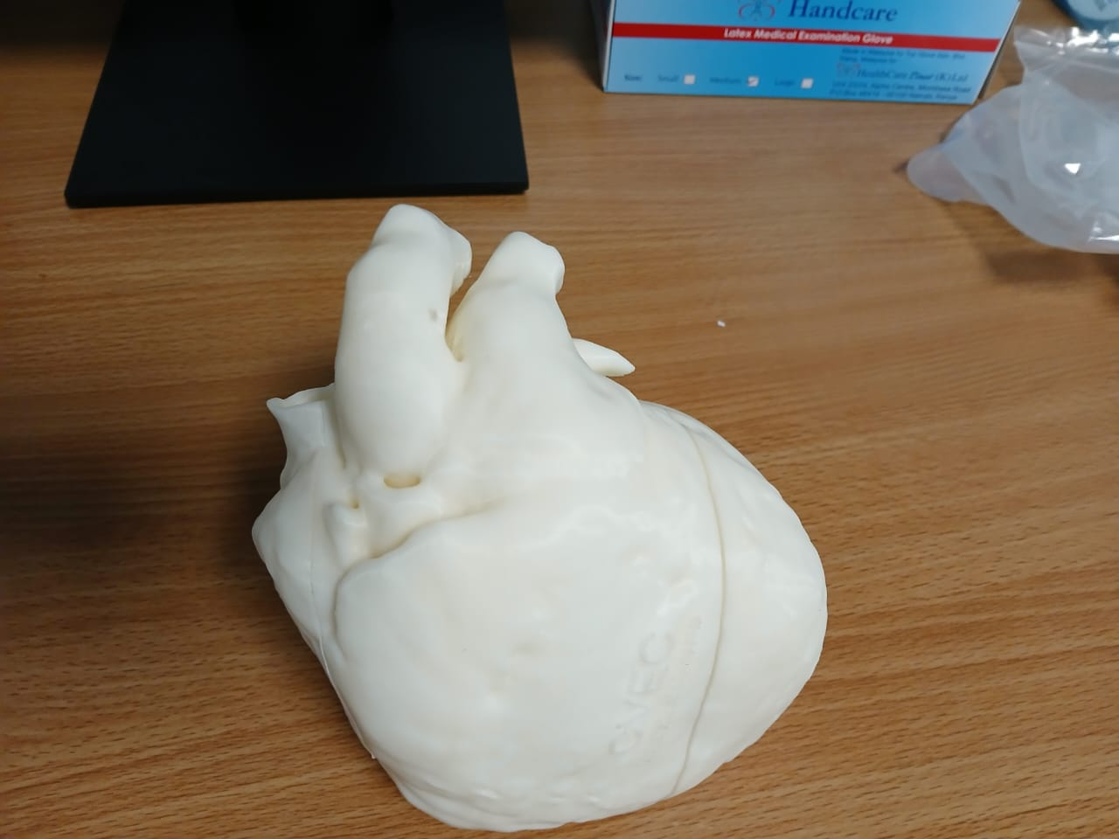
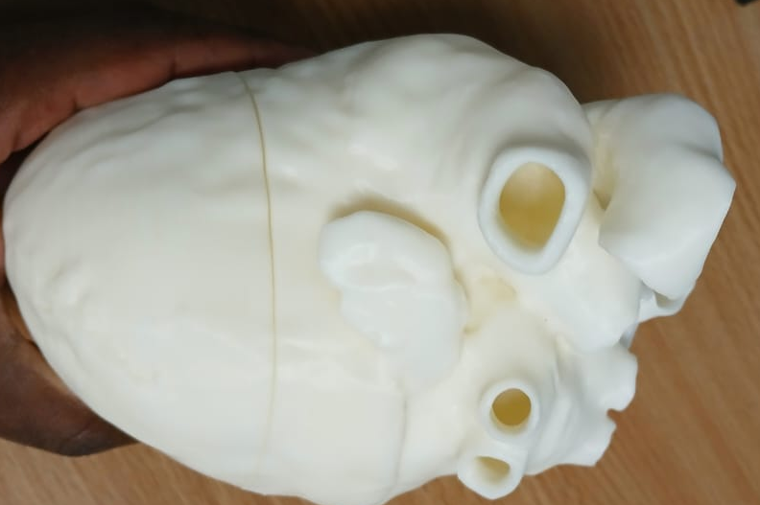
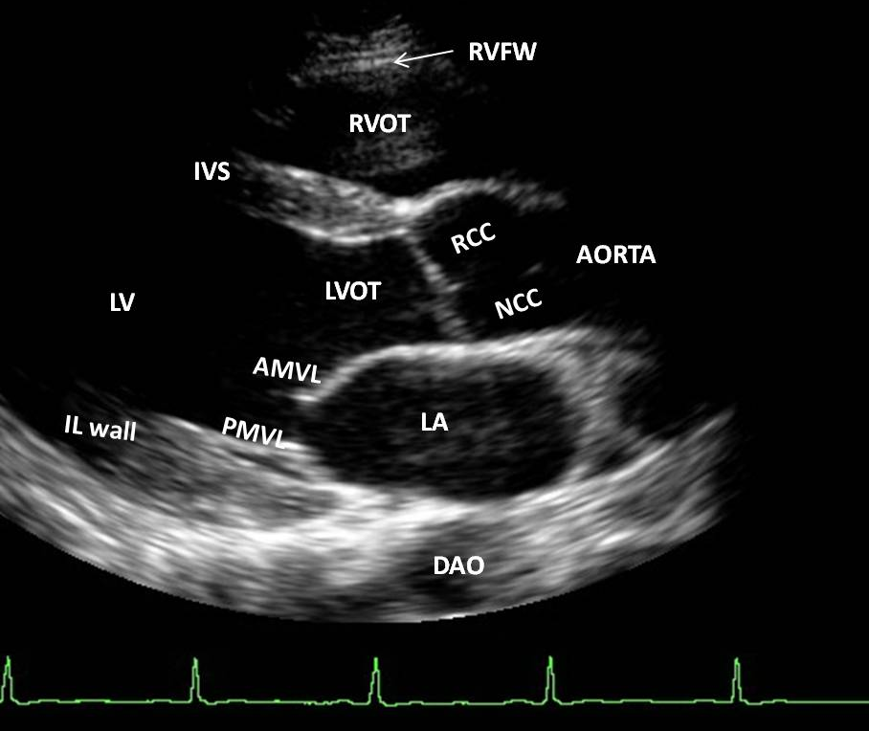
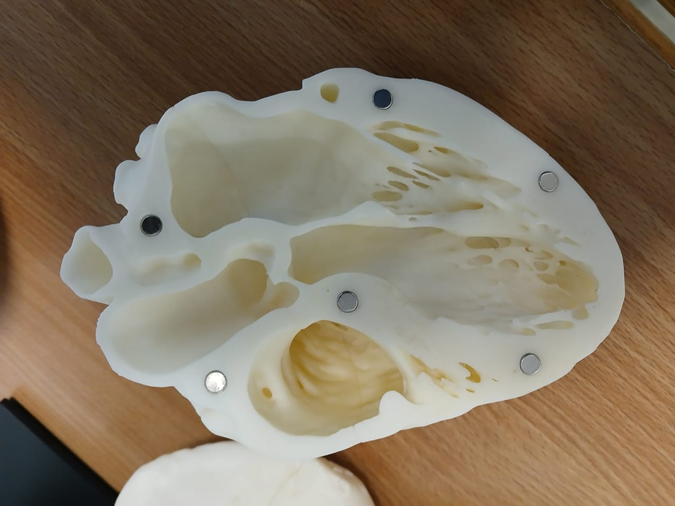
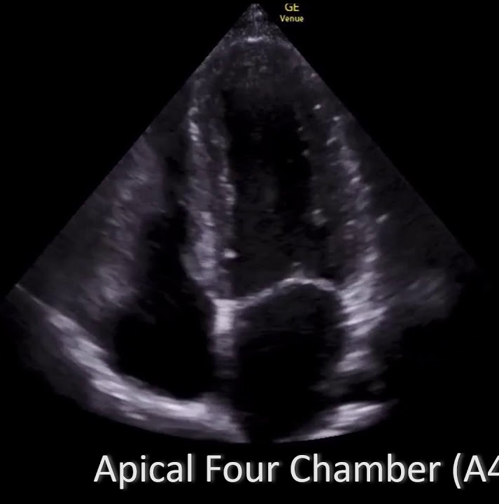
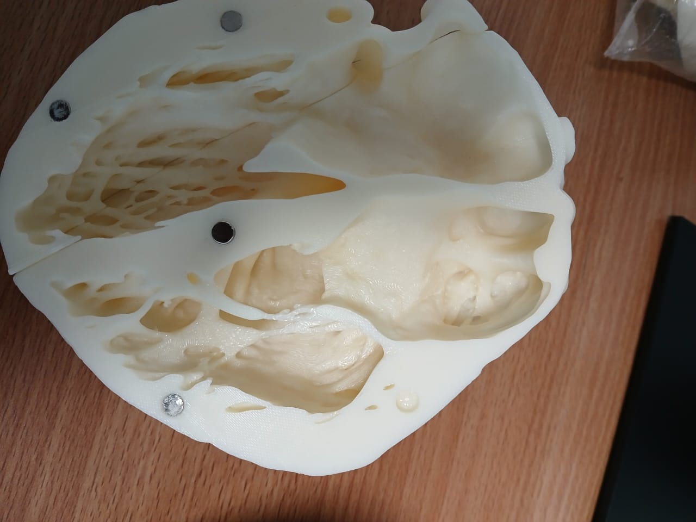
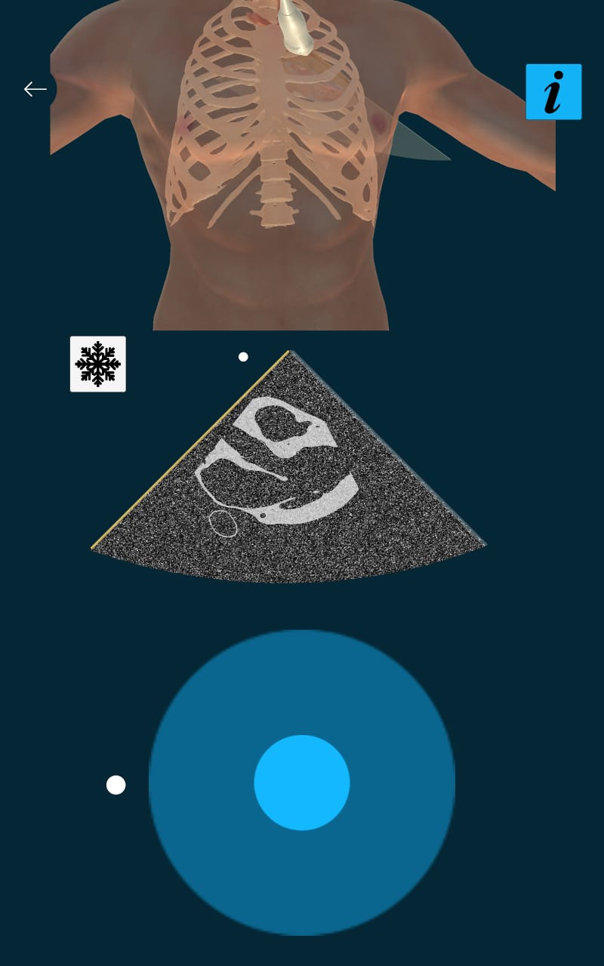
Integrating Virtual Reality Simulation for Point-of-Care Ultrasound (POCUS) Training in Sub-Saharan Africa.
Kimani Brian¹, Arango Susana², Buyck David², Ngure Phyllis ¹, Mugambi Immanuel ¹, Thairu Benjamin¹, Mwende Mercy¹, Otieno George ¹.
  AIC Kijabe Hospital, Kenya. 2. The Visible Heart Laboratories, University of Minnesota
INTRODUCTION
Methods
Few examples
Point-of-care ultrasound (POCUS) has become an invaluable tool across diverse clinical settings due to its portability, affordability, and non-invasive nature.
However, traditional POCUS training faces challenges, including limited patient availability and potential risks to patient safety.
Simulation-based training, particularly using virtual and augmented reality (VR/AR), offers a promising solution by providing a safe and realistic learning environment.
While some studies show comparable outcomes between VR and traditional training, others suggest VR's potential to enhance ultrasound skills, confidence, and procedural knowledge, especially when combined with expert instruction.
At Kijabe Hospital, a rural tertiary facility with a high volume of trainees, integrating VR-based POCUS training, alongside 3D printed models and instructor-led discussions, offers a cost-effective and accessible method to address the current limitations in hands-on training and ensure all trainees develop essential POCUS skills before entering the clinical settings.
We target to incorporate this to programs that need POCUS
Strata 1: Intensive Training
  Three consecutive days of simulation-based training.
  Small group sessions (maximum 14 students).
  VR/instructor ratio of 1:2.
  Use of 3D printed heart models and VR based TTE study for hands-on practice.
Strata 2: Spaced Training
  Three separate training sessions, one day each, spaced one month apart.
  Small group sessions (maximum 14 students).
  VR/instructor ratio of 1:2.
  Use of 3D printed heart models and VR based TTE study for hands-on practice.
Data management
OBJECTIVES
Demographic data including, Gender, level of training, type of training,
A pre and post test written exam will be done to evaluate knowledge (I.e at the first session and the last session) This to be delivered via a secured exam system.
During which competency of the ultrasound skills will be assessed including landmark location, probe manipulation, image interpretation, This will be collected and filled in a RedCap rubric
Surveys collected via RedCap before and after the simulation will be taken to evaluate level of confidence, Numbers of times to achieve competence
Semi structured interviews will be conducted to explore perceived benefits, challenges and recommendations.
To assess improvement in training capacity in a high-volume training center by leveraging VR.
To evaluate learner satisfaction, engagement, and perceived benefits of VR-based POCUS training.
To identify the determinants of effective skills transfer for VR based POCUS training.
To identify and address the challenges and limitations associated with VR-based POCUS training
To explore strategies for integrating VR-based POCUS training into existing medical education curriculum.
Areas of Focus
Where are we
Looking forward
  Cardiac – Basics, intermediate and advances cardiac sonography
  Abdominal – FAST and emergency ultrasound care
  Lung – Basic and detailed
  Musculoskeletal – DVT
  Guided procedures – central line placement, peripheral vascular access and thoracocentesis
Currently only cardiac software are developed – Both Transthoracic and Transesophageal echocardiography.
Currently – 1 class enrolled 9 students with 1 VR headset and 1 laptop
  Theory taught and practical session held in groups of 3 and 4s in their free time.
Still figuring out how to make the abnormalities in the VR and also incorporating other parts of POCUS areas in the VR
Looking for partners
  Gaming development.
  Grants – more VR boxes needed, haptic gloves and laptops to increase realism
  Also, incorporating other teaching modules e.g anatomy, physical examination, Cardiac arrest, team dynamics
If you would like to partner, support or give a suggestion you can contact me, bkimani@kijabehospital.org

