Slide 1

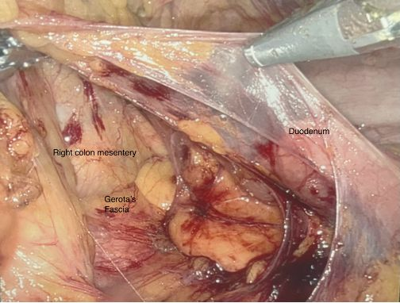
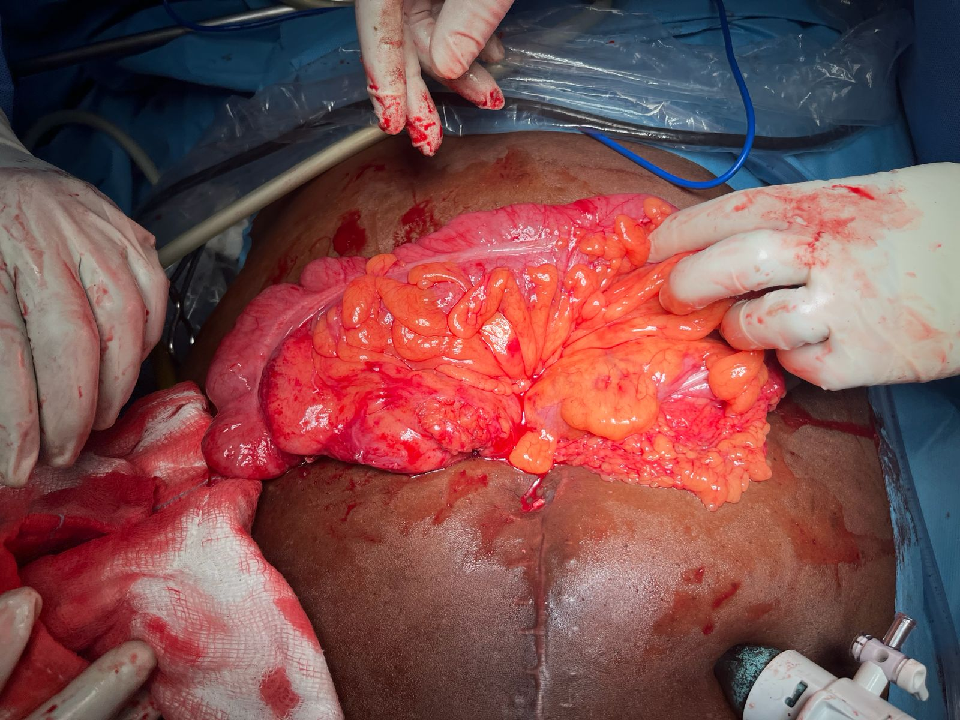
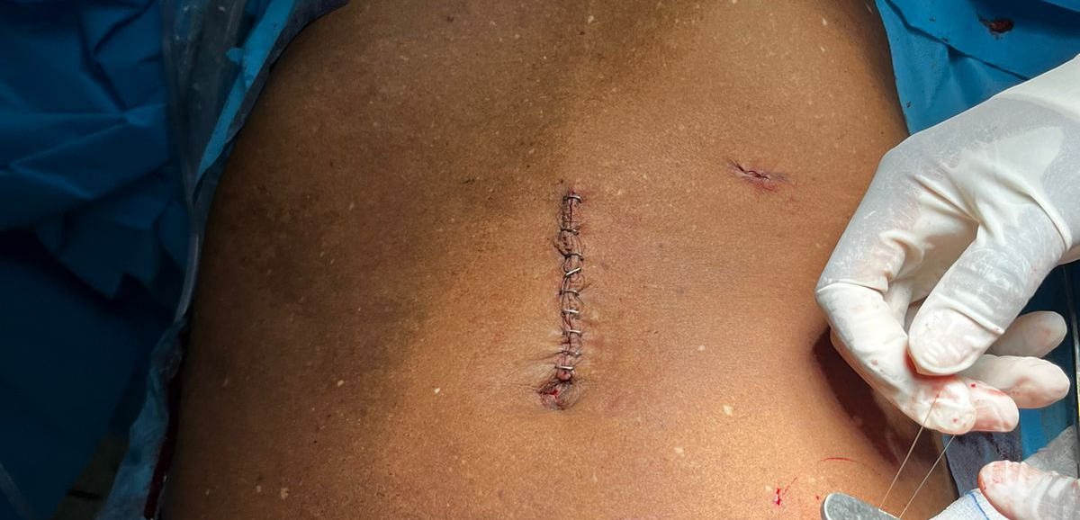
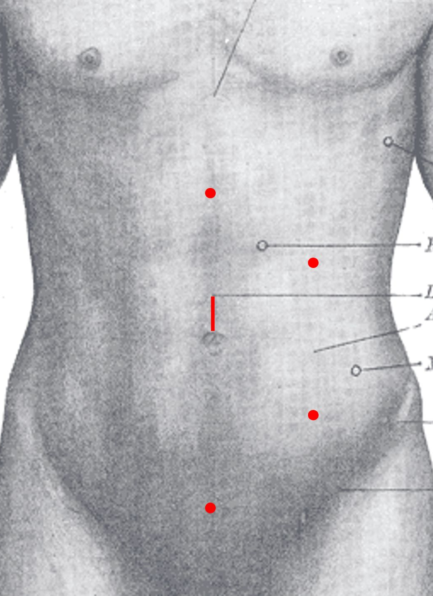
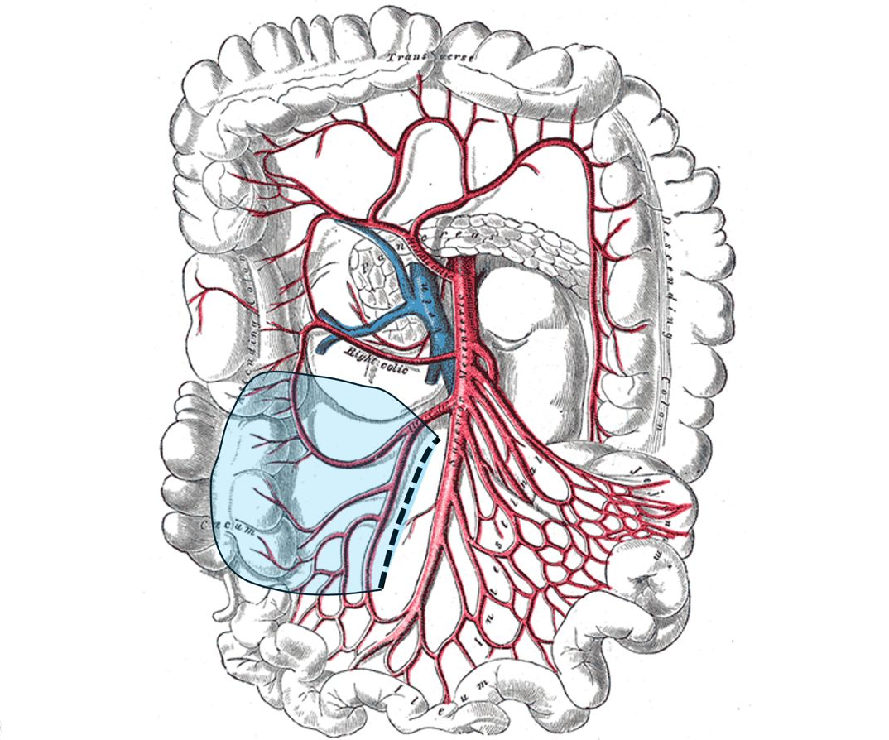
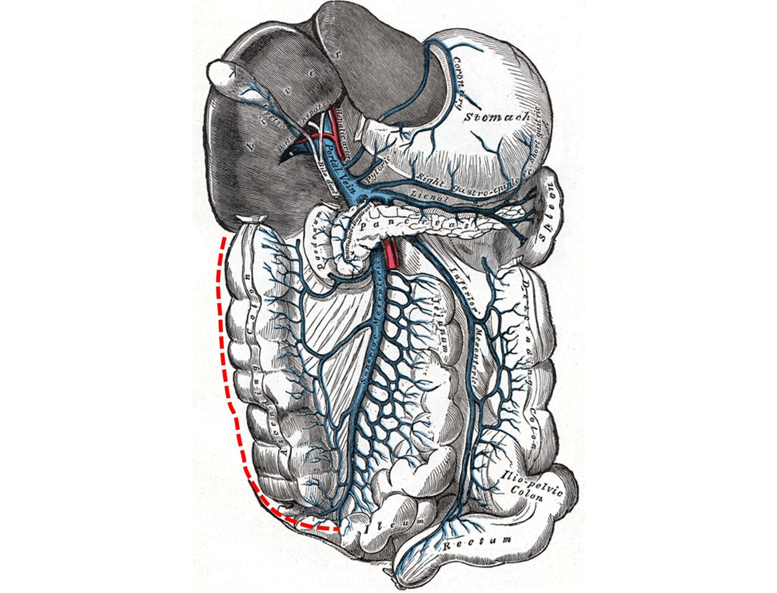
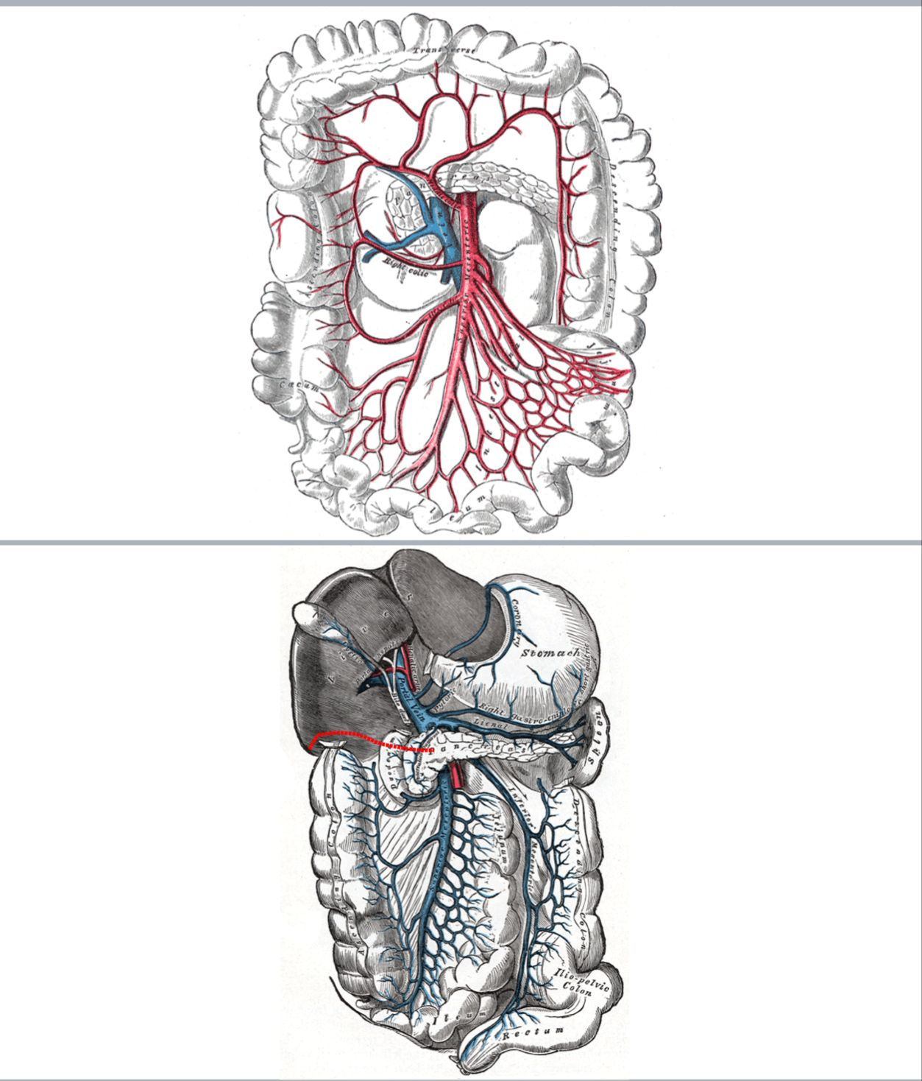
Laparoscopic Assisted Hemicolectomy at AIC Kijabe Hospital
Leahcaren N. Oundoh, Katlyn G. McKay, Afidu Lemfuka, Lydia Kersh, Maya V.Roytman, Caleb Van Essen, Joseph Nderitu, Richard Davis
Introduction
Procedure steps
Right hemicolectomy is performed for malignancy and other benign conditions.Traditionally an open approach was used but recently we have shifted to the use Minimally invasive surgery (MIS) and appreciated reduced pain recovery time and hospital stay.​
This study presents two cases of right hemicolectomy by a minimally invasive approach, highlighting our technique.​
​
4
5
Caption
Caption
METHODS
6
We reviewed two cases of right hemicolectomy. A step-by-step analysis of our laparoscopic technique was performed. Key technical steps, anatomy, and complication considerations were analyzed. The patients were a 70-year-old male with hepatic flexure adenocarcinoma and a 64-year-old female with a 5cm neuroendocrine tumor found at previous laparoscopic appendectomy.
Caption
Results
Reverse trendelenberg position, Hasson technique for ports insertion
Medial to lateral retroperitoneal dissection, following the plane between the mesocolon and the retroperitoneum,
Division of the hepatocolic peritoneum, trendelenburg position at this point
Division of the peritoneum in the right paracolic gutter.
A small paraumbilical incision is made and the ascending and right transverse colon are delivered out of the peritoneum. Supine position for this part.
Extracorporeally, vascular ligation, mesocolon division, colon and ileum division, and ileocolic anastomosis are accomplished.
The bowel is returned to the peritoneum and all incisions are closed.
Procedure steps
2
CONCLUSION
Caption
MIS hemicolectomy is associated with reduced pain and recovery time and hospital stay. We describe how to perform this operation laparoscopically without energy device or mechanical staplers.
Caption
1
3
FUTURE WORK
Future research can aim at optimizing techniques and evaluating other factors affecting complications and hospital stay.
Caption
Caption

