Slide 1

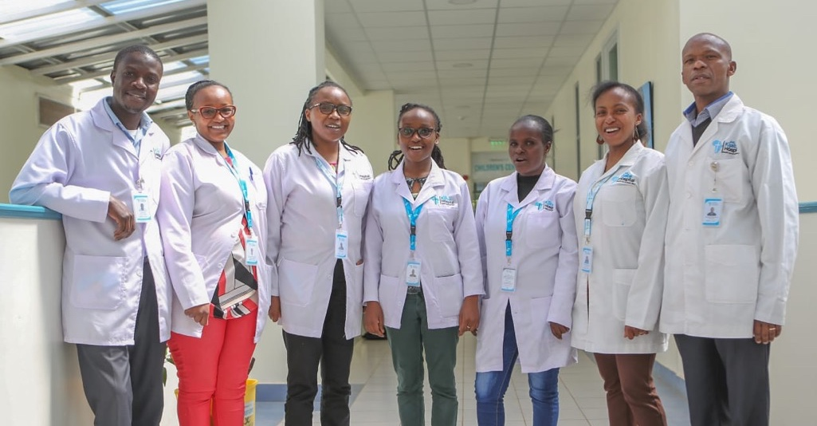
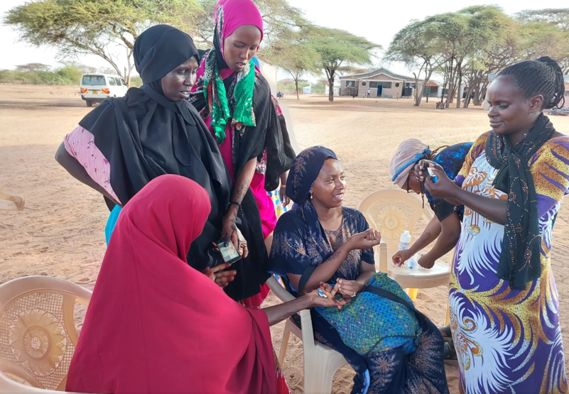
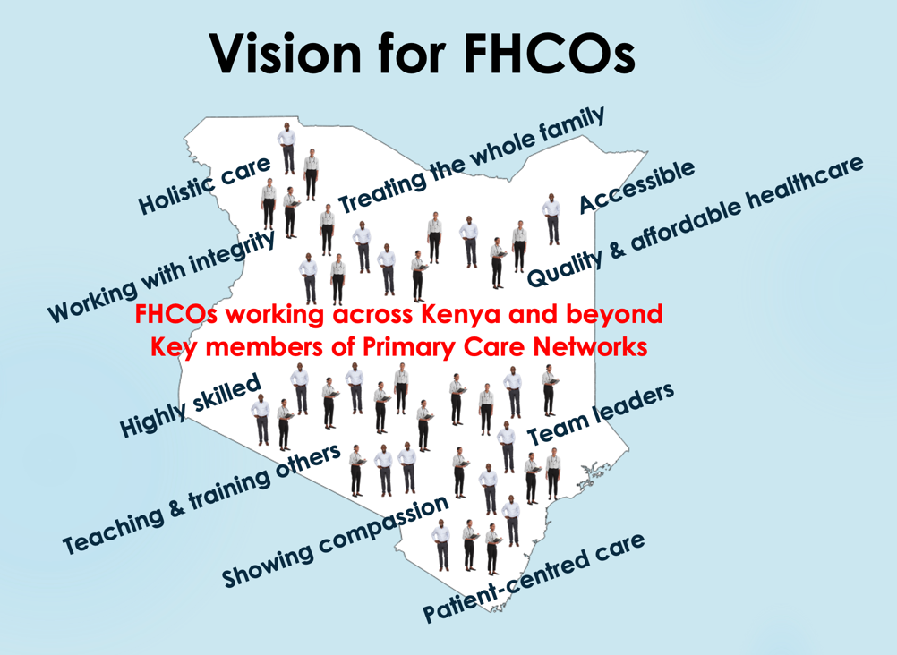
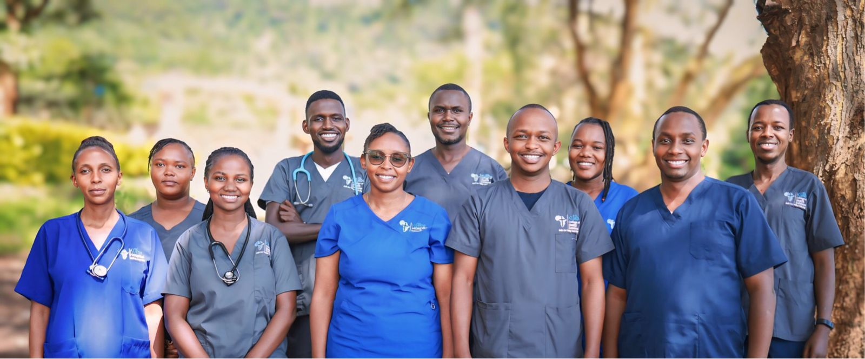
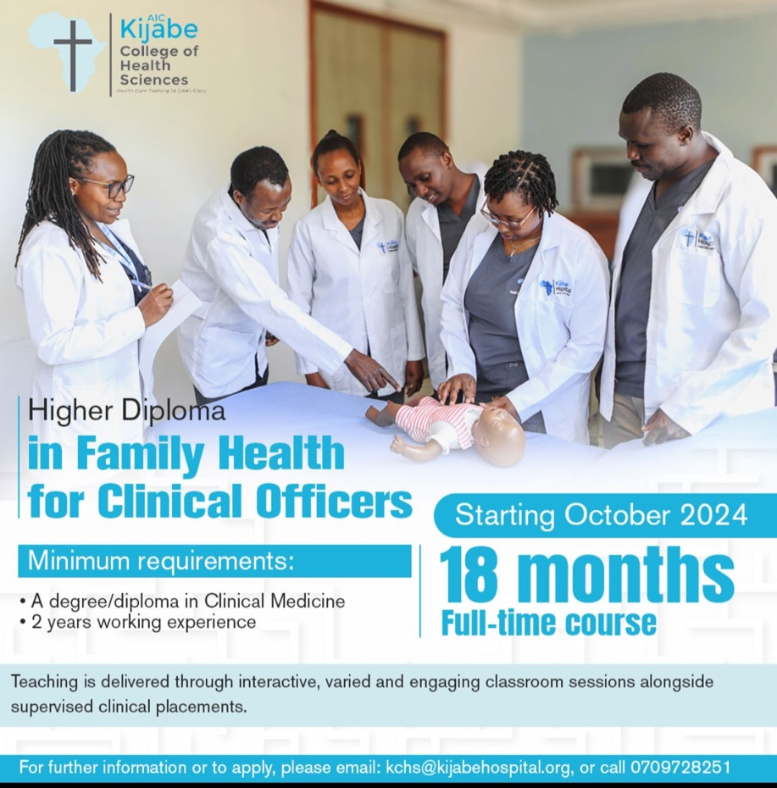
Family Health Clinical Officers: Key professionals to
strengthen primary healthcare in Kenya and beyond
Katy Linley, Irene Muthoni, Emmanuel Ndeto, Sarah Kamau, Stella Wangui, Pete Halestrap
Published: Linley K, July 2024 African Journal of Primary Health Care & Family Medicine, 16(1)
Background
Primary healthcare (PHC) is recognised as the means to achieve universal health coverage, a national priority for Kenya.^{1,2}
With only around 200 family physicians for a population of over 54 million, innovative solutions for providing quality PHC are needed. Clinical officers (COs), as mid-level health workers, already provide much of the primary care across Kenya, but have only a short time studying PHC during their basic training.
In 2020, Kenya had 25,000 COs and 13000 doctors with a higher percentage of COs work in rural areas compared to doctors.³ It has been shown that mid-level health workers are more likely than doctors to stay in underserved areas and interestingly, that there is no difference in quality of care provided between mid-level and higher-level health workers.^{4,5}
Clinical officers are therefore key professionals to play a major role in PHC across Kenya. So, the idea of a higher diploma in Family Health for Clinical Officers (FHCO) was developed.
Methods
To provide highly trained Family Health practitioners, a Higher Diploma in Family Health for Clinical Officers (FHCO) was launched by the government in 2018. With experience in delivering innovative and strategic higher diplomas, AIC Kijabe Hospital has been involved in curriculum development of this new diploma since its inception.
In October 2021 the first cohort of FHCO trainees was admitted to Kijabe College of Health Science, graduating in 2023. There is now an annual intake, with the second cohort having graduated in January 2025 and a third cohort underway.
The FHCO higher diploma lasts 18-months and aims that graduates will be experts in the field of family health. This means clinicians who can take care of individuals, families and communities in a wide range of pathologies and differentiating those who require urgent intervention or referral. We focus on clinical skills such as communication, physical examination and decision-making. There is an emphasis on patient-centred care, evidence-based medicine and lifelong learning.
Classroom teaching occurs during week-long blocks using multimedia with pre-reading and modular exams. Leveraging on the previous clinical experience of these adult learners, we use a problem-based teaching approach to encourage participatory learning.
Clinical mentorship and assessment are also undertaken during clinical placements, which are all in
primary care settings, in a variety of geographical locations and levels of care.
The curriculum also includes health system management, leadership, teaching skills and quality improvement methods meaning that FHCOs are equipped to train and lead others, thus expanding the impact of their training.
Interpretation
FHCO graduates are well-trained to deliver comprehensive, evidence-based, cost-effective and holistic care over a wide range of patient conditions. As the programme expands, we expect graduates to be working across the country and leading efforts in enhancing the health and well-being of individuals, families and communities within primary healthcare networks.
The efficient and focused training also provides very good value for money; not only because of the reasonable costs of training but also because COs are more likely than physicians to stay working in rural areas where quality PHC is desperately needed.
The FHCO programme is therefore a highly strategic way for Kenya to strengthen PHC and so to make steps towards achieving UHC. This curriculum and model of training could be shared and replicated in many parts of the world where non-physician clinicians work.
Findings
Ten FHCOs have now graduated from KCHS and are working in Kijabe Hospital clinics, Bungoma County and Garissa. The cost of the training at Kijabe College of Health Science is approximately $4000 per trainee. African Mission Healthcare and Medical Missionary News are among sponsors who have helped to support students in the early stages of this programme.
FHCO graduates are running family medicine clinics at AIC Kijabe Hospital and its satellite clinics, providing continuity of care for patients with multi-morbidities. FHCO graduates are now part of the faculty and are involved in teaching COs, interns and on several short-courses.
References
World Health Organization. Primary health care. 2024.
Kenya Primary Health Care Strategic Framework 2019–2024. MOH.
Mbindyo P, et al. The role of clinical officers in the Kenyan health system: A question of perspective. Hum Resour Health. 2013;11:32.
Mullan F, et al. Non-physician clinicians in 47 sub-Saharan African countries. Lancet. 2007;370(9605):2158–2163.
Lassi ZS, et al. Quality of care provided by mid-level health workers: Systematic review and meta-analysis. Bull World Health Organ. 2013;91(11):824–833.

