Slide 1


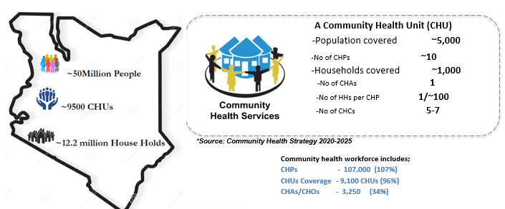
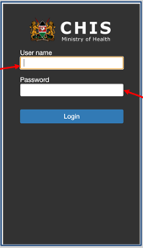
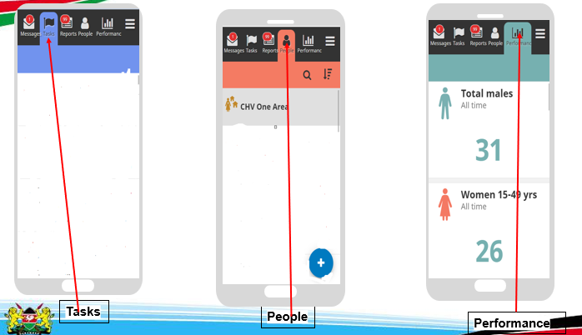
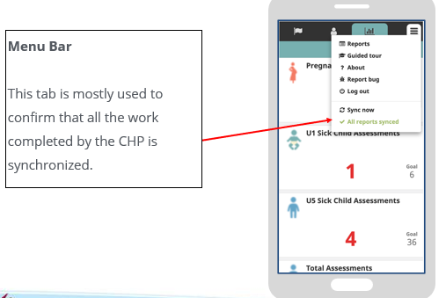
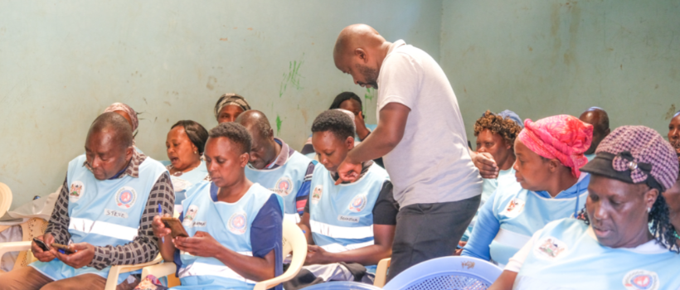
AIC KIJABE HOSPITAL COMMUNITY HEALTH PROGRAM: TROUBLE SHOOTING IMPLEMENTATION OF eCHIS KENYA.
Ogweno Brian, Simon Mbugua, Wambui Makobu, Wilson K. Kamiru, Brenda Chepkemoi
AIC Kijabe Hospital
Background
Findings
Interpretation
The Electronic Community Health Information System (eCHIS) is a key digital innovation aimed at collecting and reporting real time data from the household level that enables evidence based timely intervention for health services. The data collection and reporting is done by Community Health Promoters (CHPs) in Kenya who visit households seeking health information and provide health services.
In 2024 AIC Kijabe Maternal & Newborn Community Health Program (MNCH) intervened in Lari, Naivasha, Limuru and Kinangop Sub Counties where implementation of eCHIS faced myriad of challenges. They ranged from under reporting due to poor retention of knowledge to apply, navigating through new technology including use of smartphone and poor selection criteria of CHPs.
We assessed the outcomes of eCHIS trainings and recorded what Community Health Promoters didn’t know and what they understood after troubleshooting.
Significance of Results: Addressing the identified challenges will improve data accuracy, enhance service delivery, and strengthen the integration of community health data in the Kenya Health Information system.
Limitations & Strengths: While training improved eCHIS usability and user competence, ongoing support, system refinements, and recruitment of additional CHAs/CHOs are needed for full-scale effectiveness.
Potential for Global Health Innovation: Strengthening digital health tools like eCHIS can serve as a model for other low-resource settings seeking to improve community health data quality and health service delivery.
I (CHP) didn’t Know | Now I know
“ I didn’t know where to locate different workflows and services within eCHIS application for this reason, I haven’t gone to the field in the past one month. | Now I am able to locate different workflows and services on eCHIS and I can competently go the field and work with eCHIS”
“ Completing the pending tasks has been a big challenge leading to huge backlogs.” | “I now have a good understanding of all task based services I had pending including registration reminders, Client detail Verification and registration reminders. Beginning today I will start clearing them slowly”
“I am not aware of how to rectify mistakes I made during HH Registration.” | “I am now able to located edit icon to correct mistakes made during initial entries”
“I have been struggling interpreting mandatory fields required for me to complete filing in my data” | “Today I have learnt fields with asterisk are mandatory and must be filled in order to proceed”
“All of us have experienced difficulties in syncing affecting our reporting and receiving timely updates.” | “You have really helped us. Now all of us are having our reports synced”
“It is like when we are being trained for the first time. We were not aware of these on Version 3 Updates such as first aid services and expanded health assessments. Aha! That these we didn’t know” | “We have learnt the existence of new updates, features and services that we weren’t aware of. These will greatly improve our performance”
“We are conducting hypertension and diabetes screenings in communities but we do not know how how to use eCHIS for documentation. | “Today I have gained skills and Learnt utilization of eCHIS on screening of hypertension and diabetes.”
I have never recorded equipment and commodities I was given because I don't know how to do it. We have already used most of them. | “Today I have earnt commodity and equipment mgt on eCHIS including commodity count & return. How I wish this was shown to us earlier, we would have prevented losses that have already occurred.”
Conclusion
The induction and sensitization that was done initially was inadequate. Follow up trainings done by Kijabe Hospital MNCH enhanced knowledge retention and skills improvement among CHPs. They confessed their ability to negotiate complex technological applications after one-on-one support from facilitators.
It takes more time and patience to train people with low digital literacy level.
eCHIS has great potential, if the implementation is adequately supported, Kenya’s Primary Health Care can achieve milestone improvements in service delivery, data accuracy, and decision-making.
Strengthening training, technical support, and infrastructure will ensure seamless adoption, ultimately enhancing community health outcomes and system efficiency
Methods and Material
Future Direction
This project was done in Lari, Limuru , Naivasha and Kinangop Sub Counties. Community Health Promoters represented 13 wards from various Sub Counties. CHPs were selected using the purposeful method. These were the underreporting groups from the Sub Counties.
Study involved 369 Community Health Promoters from the 4 Sub Counties who were recruited through an invitation made by their immediate supervisors, Community Health Assistant (CHA)
Training was held for two days involving group discussions, one on one support in navigating through the icons, return demonstrations on work flows, skill practice on use of CHP kits and recording finding, paraphrasing to enhance understanding through translation of English to local language, peer to peer verification of data entered on eCHIS
We also were open to CHPs calling MNCH staff when they are in the field and experiencing challenges.
Practical hands-on training equipped Community Health Assistants (CHAs) with the skills necessary to train CHPs ensuring sustainable knowledge transfer and continued support supervision to enhance long term eCHIS adoption and effectiveness.
Assess the impact of the training on actual data collected at the household level.
Acknowledgments
We acknowledge AIC Kijabe Hospital for allowing our MNCH team to carry the name of the hospital as we reach out to Community Health Workers with trainings. We are also sincerely grateful to Kiambu County, Nakuru County and Nyandura specifically Lari Subcounty Community Health Focal Person (SCHFP), Limuru SCHSF, Naivasha SCHSFP, Kinangop SCPHO for working alongside the MNCH team to make this project a success

