Slide 1
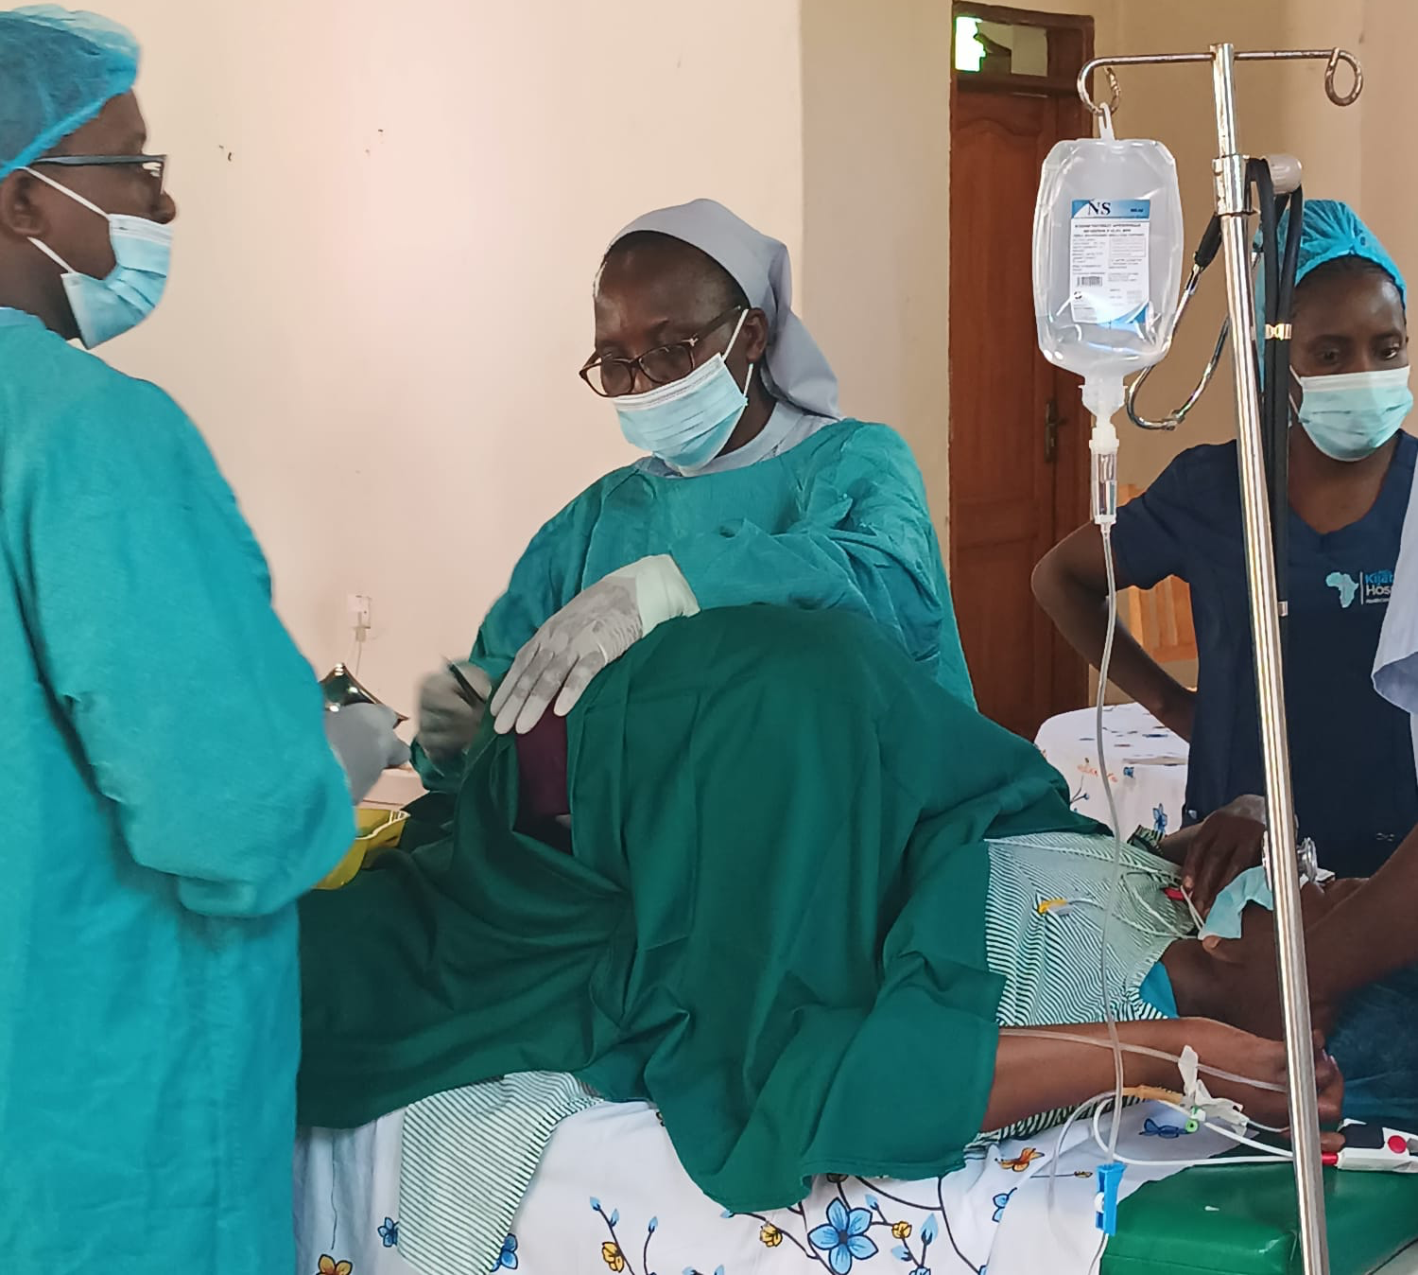
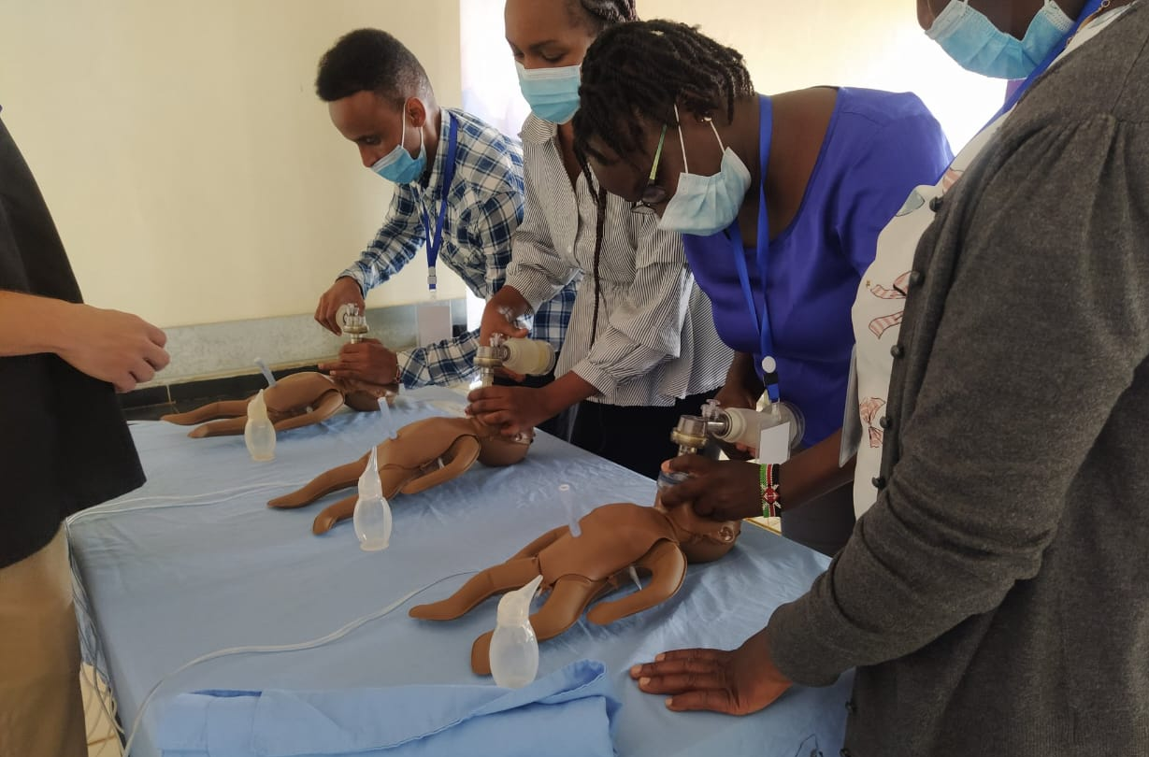
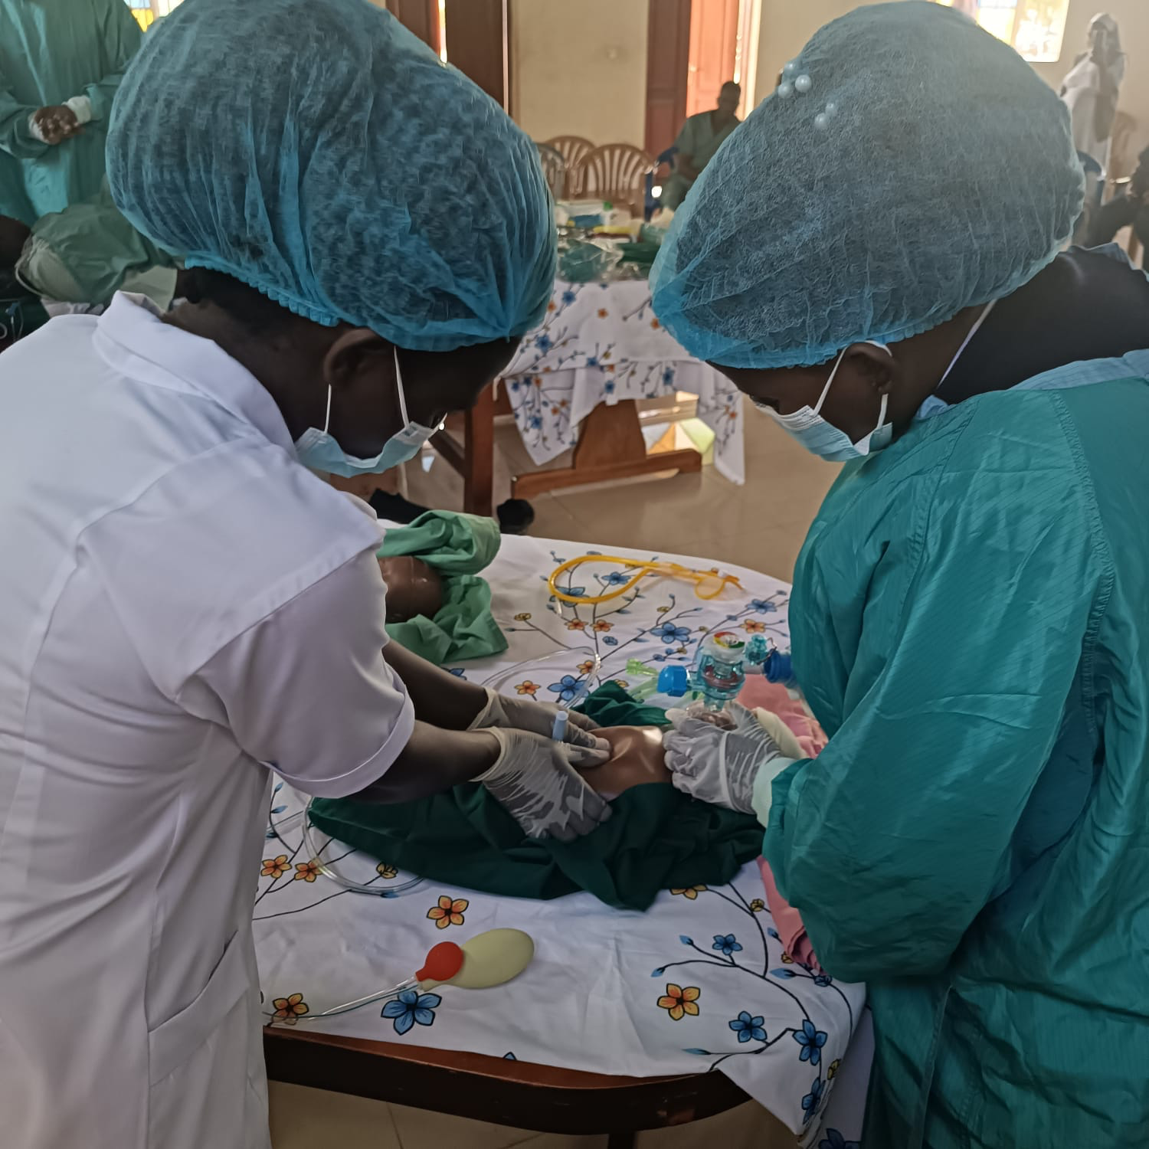
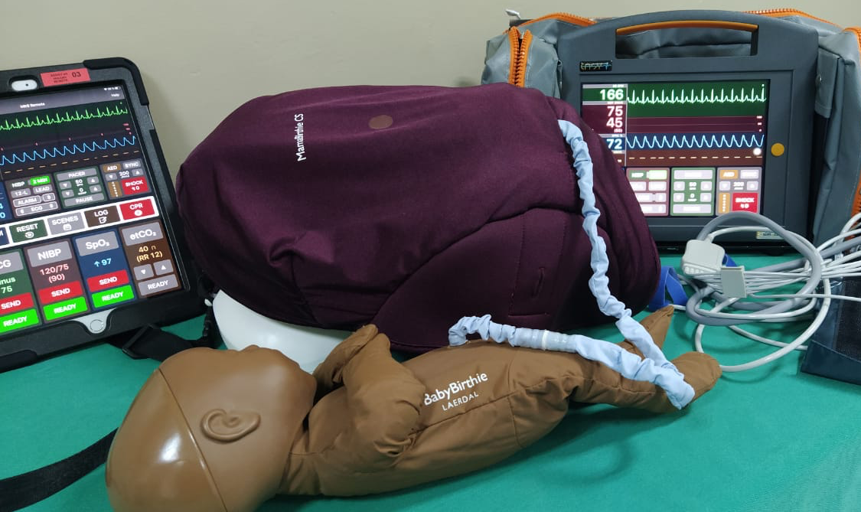
ASSESSING THE EFFECTIVENESS OF MOBILE OBSTETRICS SIMULATION TRAINING IN A LOW RESOURCE SETTING: A PRE-TEST AND POST-TEST STUDY
Phyllis Ngure*, Faith Mungai, Immanuel Mugambi, Mary Mungai
INTRODUCTION
Maternal mortality in low- and middle-income countries (LMICs) remains alarmingly high, with Kenya reporting 342 deaths per 100,000 live births as of 2017. Most deaths result from preventable causes like hemorrhage, infection, and obstructed labor, often due to gaps in skills and resources for managing obstetric emergencies.
The Mobile Obstetric Simulation Training (MOST) program, developed by ImPACT Africa, addresses these gaps by equipping hospital-based teams with critical skills to manage emergencies and improve maternal and neonatal outcomes. Using a train-the-trainers model, MOST integrates medium-fidelity simulation to build local capacity and enhance care delivery in resource-limited settings.
METHODS / INNOVATION
The program uses cost-effective simulation tools to enhance sustainability and scalability. Training features three stations: obstetric emergencies, neonatal resuscitation, and airway management. The Laerdal MamaBirthie C/S simulator, worn by a trained actor, and the SimCare Easy2 mock monitor system enables real-time vital sign manipulation for dynamic learning.
Clinical data from obstetric cases is collected two weeks before and three months after training and recorded in a REDCap database designed to assess adherence to the Safe C-Section Checklist and track maternal and neonatal outcomes as well as pre and post test results.
RESULTS
The MOST program significantly improved participants' skills and confidence in managing obstetric emergencies, communication, leadership, situation monitoring and support within a team.
Pre-training data collection (Baseline assessment)
Hands-on simulation training
( Lectures, scenarios & debriefing)
CONCLUSION
These findings support the broader implementation of simulation-based training to improve maternal and neonatal outcomes in Sub-Saharan Africa. In summary, the data confirms that there is a significant improvement in the MOST from pre- to post-intervention We extend our gratitude to AIC Kijabe Hospital, ImPACT Africa, MOST program team for their dedication to improving maternal and neonatal care. Special thanks to our funding partners. Your commitment has been instrumental in enhancing obstetric emergency response through simulation-based education.
Post-training Evaluation
REFERENCE
The Joint Commission. Sentinel Event Alert 30: preventing infant death and injury during delivery. Available at: https://www.jointcommission.org/senti nel_event_alert_issue_30_preventing_i nfant_death_and_injury_during_delive ry/. Accessed September 20, 2019

