Slide 1


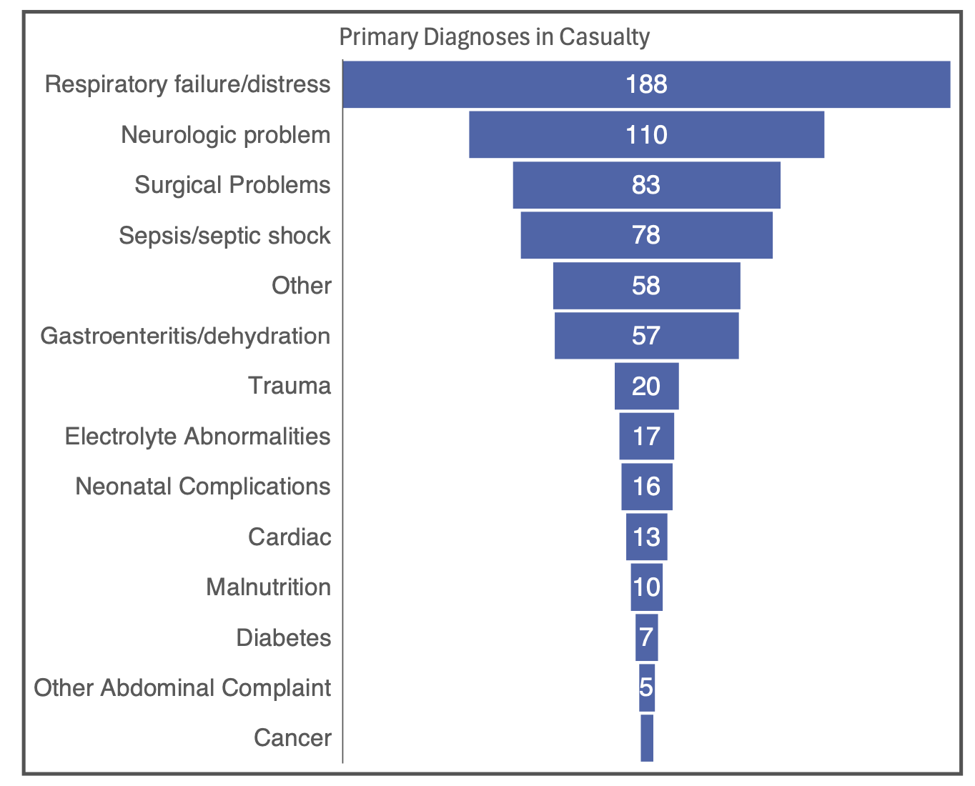
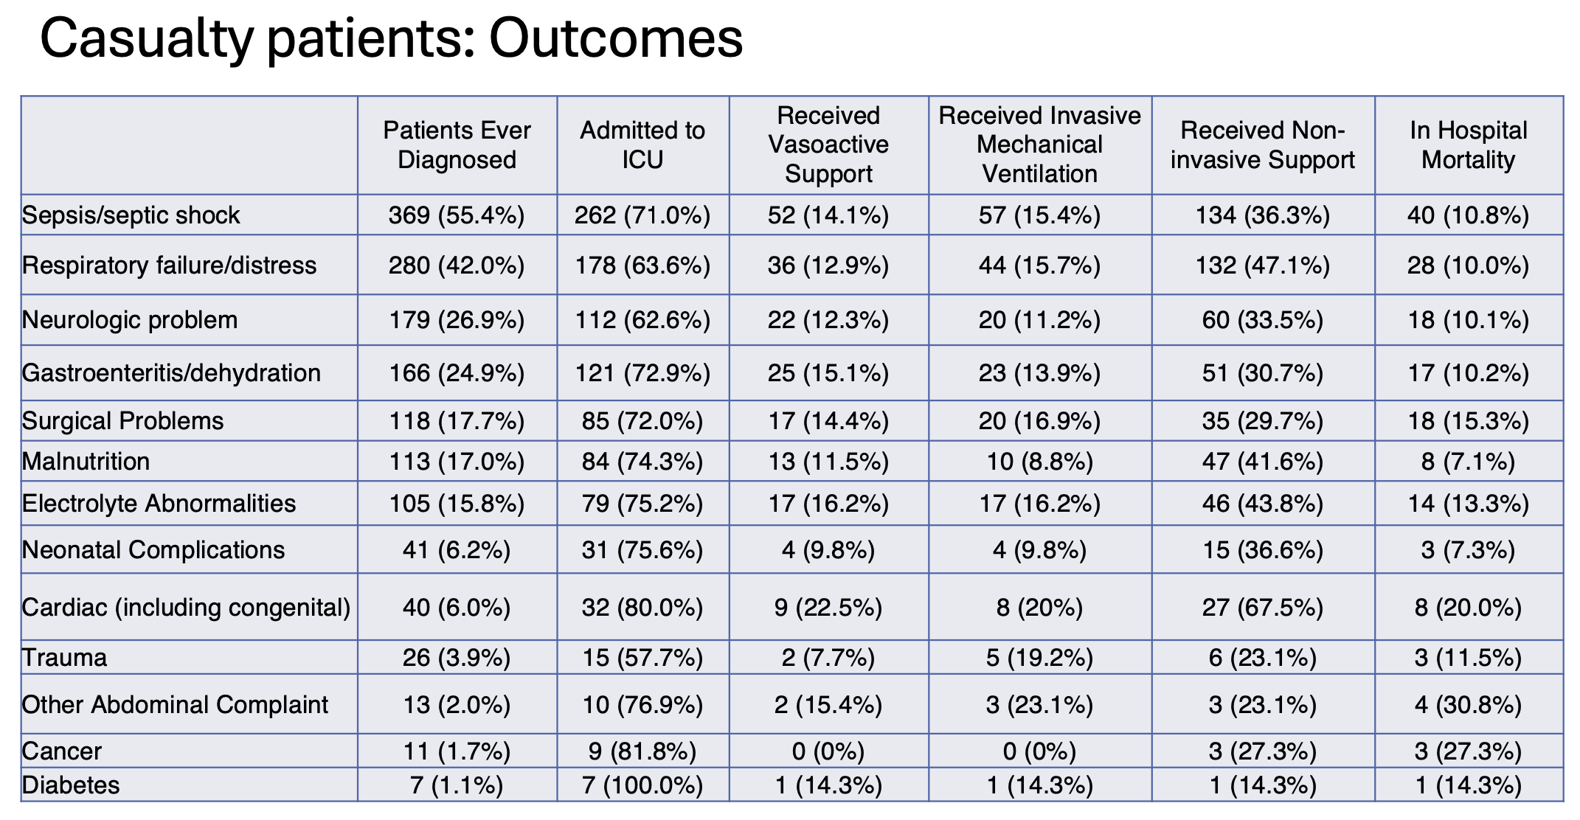
Diagnoses and Outcomes of Pediatric Admissions from AIC Kijabe Hospital Casualty
Arianna Shirk, Caleb Karanja, Emily Hartford, Amelie von-Saint Andre von Armin
Introduction
Results
Conclusion
Data from multiple countries in Sub-Saharan Africa show mortality early after hospital presentation, especially in Pediatric Patients and 31%-66% of inpatient mortality occurs within 24-48 hours. Little data has been published about the cause, mortality rate and interventions at these hospitals to better understand care needs to improve morbidity and mortality.
We analyzed 665 patients with a median age of 1 year with 71% from rural living environments. 614 of the casualty patients were admitted to hospital, with 65% of them being admitted to HDU/ICU. 8% of pediatric casualty patients were discharged home. Mortality of patients admitted from casualty was 9.2%. Respiratory distress and neurologic diagnoses were the most common diagnoses in casualty. Of the 430 patients admitted to PICU, average length of stay was 9 days (Range 0-107 days) with 12.8% mortality. Of those surviving to discharge, 15 % had a decline in their POPC and PCPC scores from pre-illness baselines
Highest frequency diagnoses in casualty and then admitted to PICU would benefit from efficient and protocolized emergency support with focus on respiratory and neurologic conditions and then subspecialty protocols. Medical, surgical teams should both be incorporated into these trainings and protocols development.
Methods
We conducted a prospective study patient diagnosis, interventions, outcome and followup functional scores s on all children presenting to the Casualty Department at AIC Kijabe Hospital. We performed etrospective analysis of all patients triaged to casualty. casualty visits and HDU/PICU admissions with outcomes at discharge at AIC Kijabe Hospital from 2020-2024. Data was analyzed using STATA .
Other symptoms:
Vomiting
Abdominal Pain
Irritability
Dysuria
References
Kortz, Teresa BAbdul-Mumin, Alhassan et al. Prevalence, aetiology, and hospital outcomes of paediatric acute critical illness in resource-constrained settings (Global PARITY): a multicentre, international, point prevalence and prospective cohort study. The Lancet Global Health, Volume 13,
Issue 2, e212 - e221
Arugnolaro V, Fovino LN, Calgaro S, Putoto G, Muhelo AR, Gregori D, Azzolina D, Bressan S, Da Dalt L. Pediatric emergency care in a low-income country: Characteristics and outcomes of presentations to a tertiary-care emergency department in Mozambique. PLoS One. 2020 Nov 4;15(11):e0241209. doi: 10.1371/journal.pone.0241209. PMID: 33147242; PMCID: PMC7641453.

