Slide 1
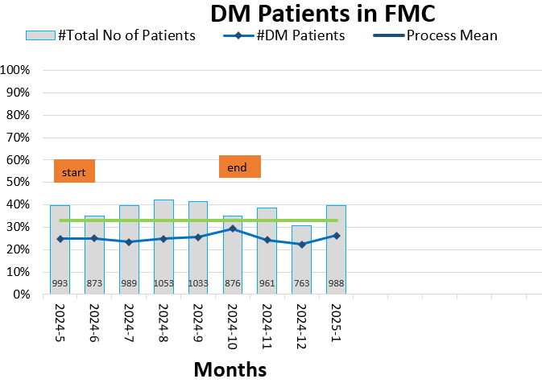
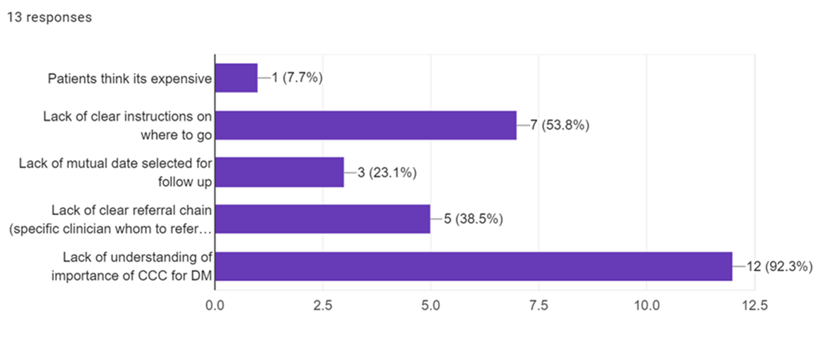
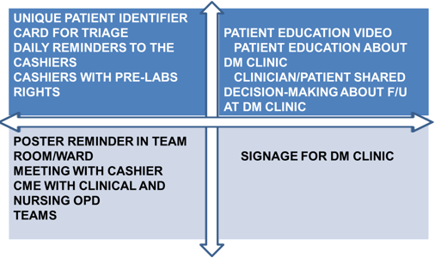
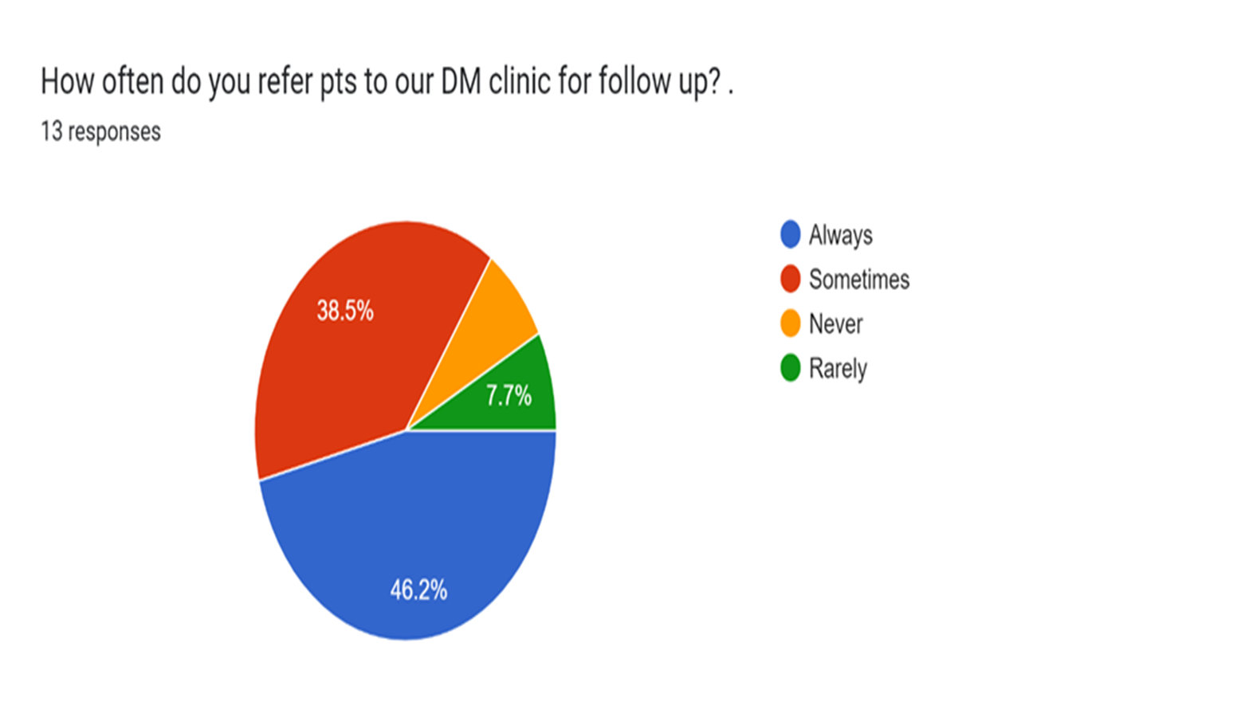
Moving Diabetes Patients to Diabetes Clinic
Stella Wangui, Anastacia Lau, Joram Jomo, Stella Khavugwi, Mercy Wambui, Stella Kibet
Abstract
Methods and Materials
Results
Objective: This quality improvement project aimed to enhance the care of patients with diabetes by transitioning them from various outpatient clinics to a dedicated diabetes clinic for long-term follow-up. The project focused on improving continuity of care, medication adherence, and glycemic control.
Methods: The project, which spanned four months, involved identifying all diabetes patients receiving care at non-specialized outpatient clinics. These patients were systematically moved to the diabetes clinic, where a multidisciplinary team could provide comprehensive, specialized care. The transition process included patient education, coordination with healthcare providers, and review of existing discharge plans to ensure a smooth transfer
Results: By the end of the four-month period, the project successfully achieved its goal and could serve as a model for other outpatient settings aiming to improve diabetes management.
The project is one of 5 collaborative quality improvement projects done simultaneously in Diabetes care done in different clinics within the outpatient service at Kijabe Hospital over a 4-month period. Teams were equipped with QI knowledge through blended virtual training and physical mentoring from their coaches. Weekly meetings to brainstorm on root causes, key drivers, interventions and sustainable action plans were done. A synthesis matrix to identify the most effective measures to bring about improvement was drawn. Interventions deemed to be high yield and low effort were applied and results obtained at the end of the project.
Tracking of the number of patients attending the Diabetes clinic was done over a 4-month period, with interventions tested every few weeks. Meetings with staff in the outpatient department , waiting area facelift at the clinic, reminders in clinical spaces and patient involvement were some of the interventions. Despite a natural disaster and nationwide doctors’ strike in government hospitals, the project saw nearly 40% improvement at it’s peak in end of May.
PROBLEM ANALYSIS
Introduction
BACKGROUND: Diabetes care requires comprehensive, longitudinal care, preferably at a long-term follow-up clinic. At the general outpatient clinic, inadequate follow-up contributes to insufficient continuity of care, poor medication compliance, poor adherence to dietary modifications, and complications due to poor glycemic control. In contrast, long-term follow-up at a diabetes clinic involves a multidisciplinary team that provides comprehensive care. Increasing the uptake of follow-up at the diabetes clinic from the general outpatient clinic will improve the quality of care for these patients.
SMART GOAL: To increase the patient attendance at Diabetes clinic to 35% in 4 months from March 2024 to June 2024
Sustain Plan
Key Learning Points
Change is possible
An attainable target encourages teams to work together
Hospital policy for QI helps sustain change
Next Steps
Expanding improvements to the in-patient department
Continuing quality improvements within the DM clinic- TAT, waiting bay facelift, signage and addition of allied staff to expedite services
Synthesis Matrix
Contact
References
Stella Kibet
Kabarak University, Family Medicine
Email:stellakibet@kabarak.ac.ke

