Slide 1
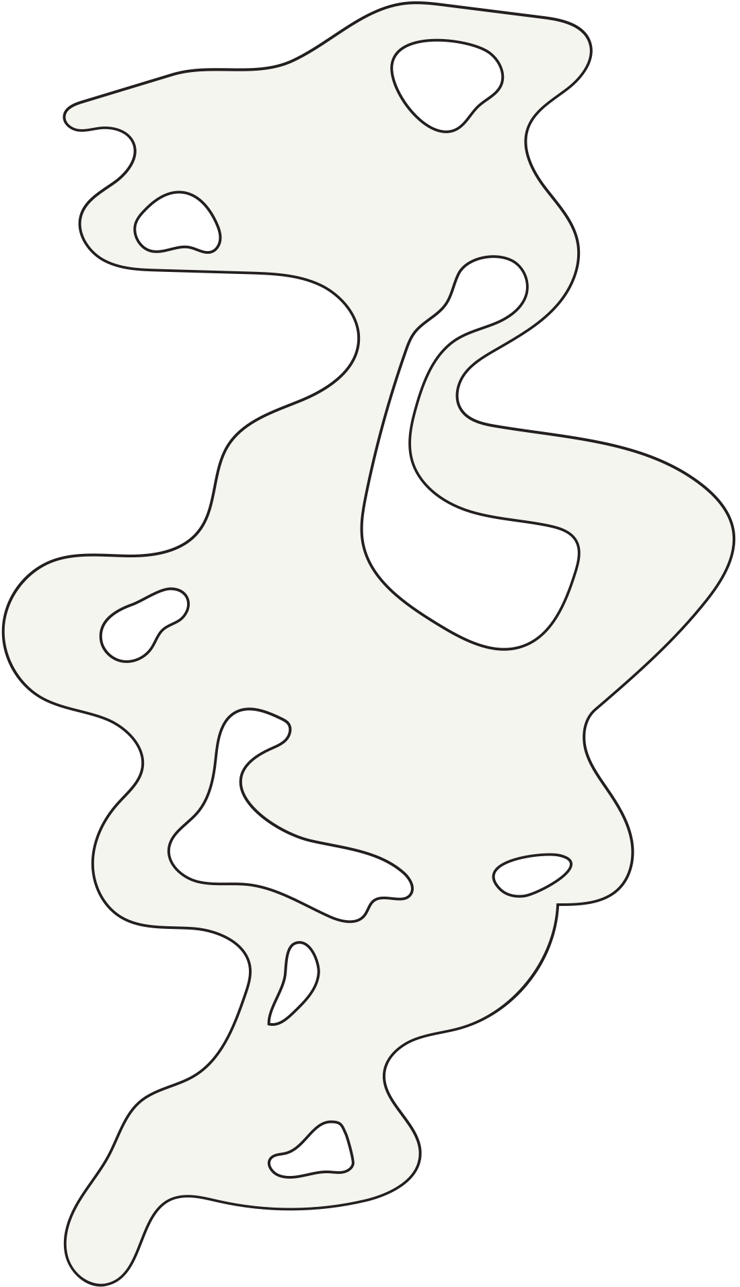
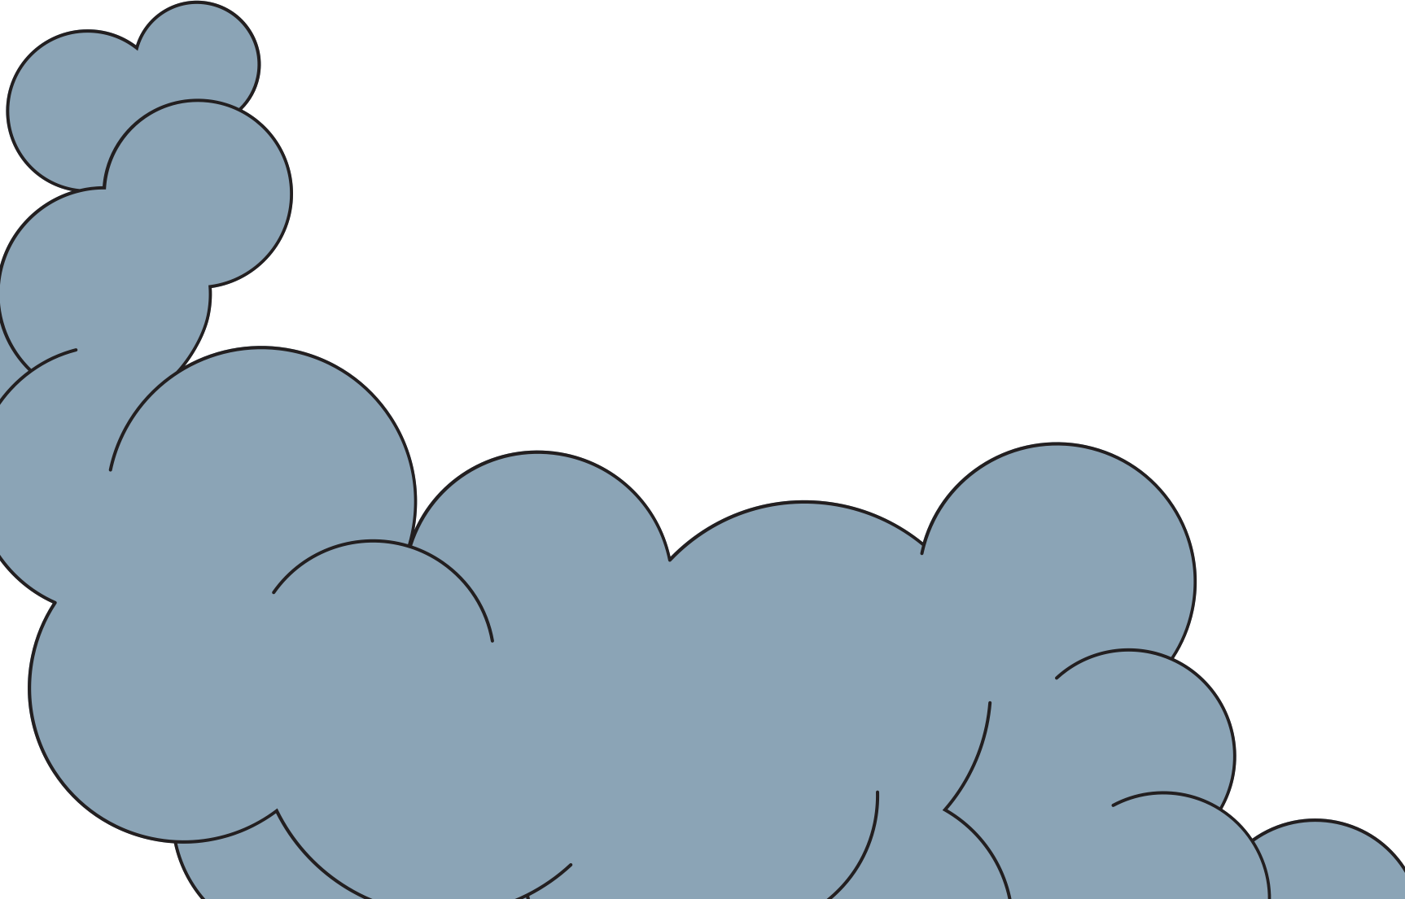


Moving DM Patients to DM Clinic
Quality Improvement
2024 Diabetes Cohort

Slide 2




MOVING DM PATIENTS TO DM CLINIC
At the general out-patient clinic, Inadequate follow-up contributes to:-
Insufficient continuity of care
Poor medication compliance
Poor adherence to dietary modification for diabetes
Complications of diabetes from poor glycemic control

Slide 3
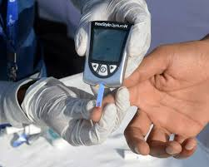

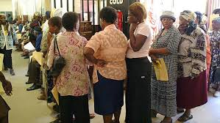
Comprehensive Care in DM Clinic
Diabetes care requires comprehensive, longitudinal care, preferably at a long-term follow up clinic
Long-term follow-up at the diabetes clinic entails a multidisciplinary team provides comprehensive care
Increasing the uptake of follow up at diabetes clinic from the general out-patient clinic will improve quality of care for these patients

Slide 4
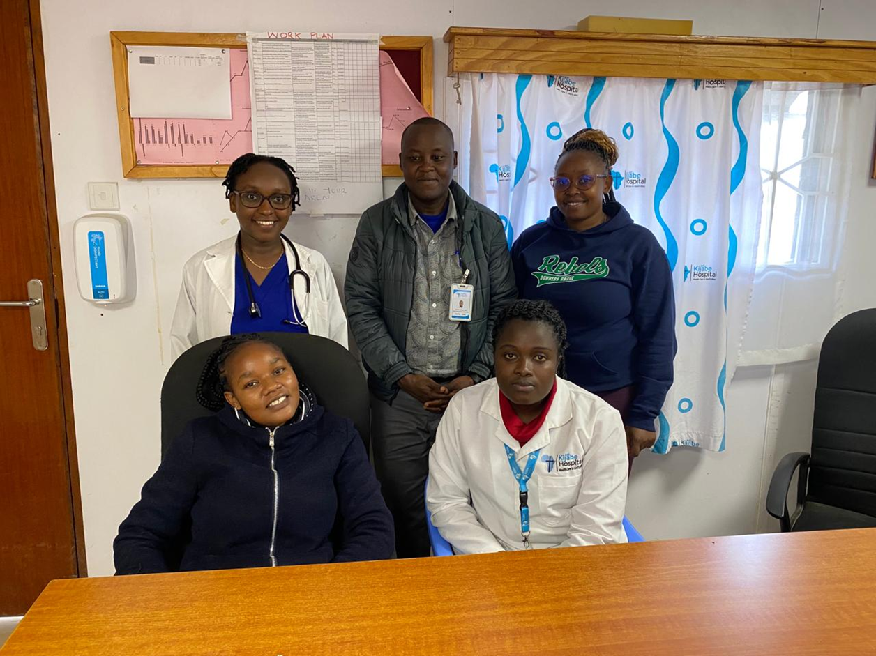
THE TEAM
Team lead: Stella Wangui
Anastacia Lau
Joram Jomo
Stella Khavugwi
Mercy Wambui
Mentor: Stella Kibet

Slide 5
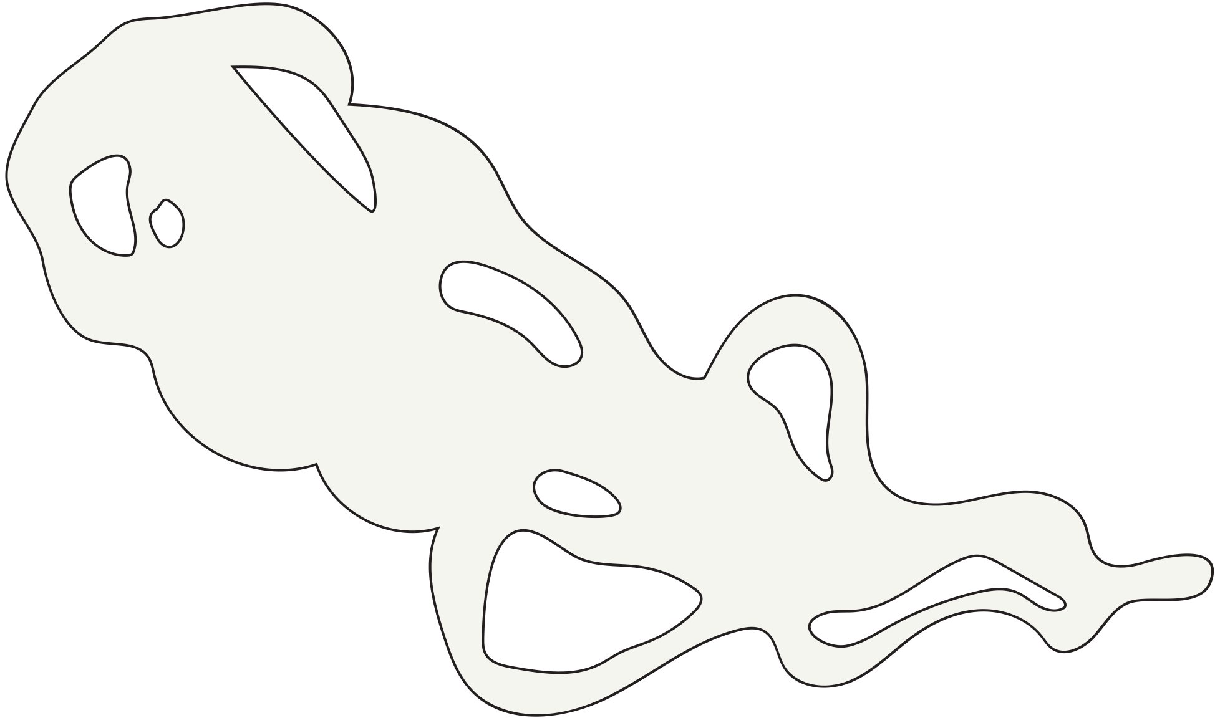
TARGET
To increase the patient attendance at Diabetes clinic by 25% in 4 months from March 2024 to June 2024
How did you determine this was the best goal for your project?
Emphasis is on clarity

Slide 6
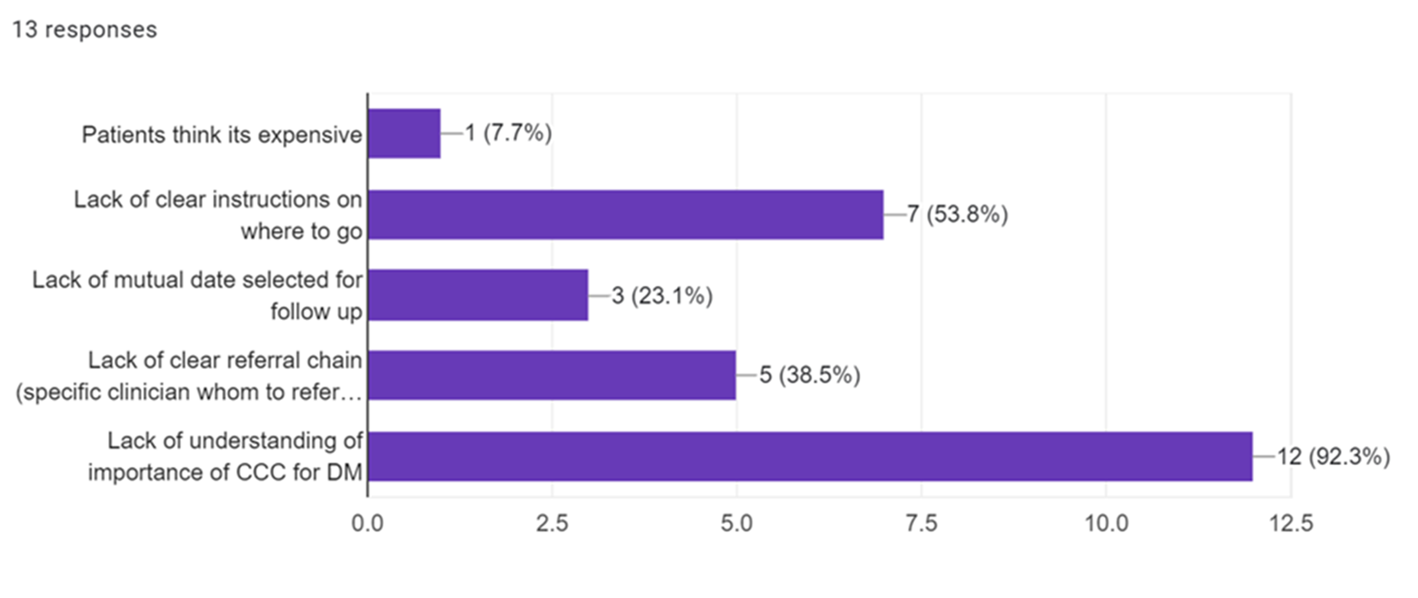
Problem Analysis

Slide 7
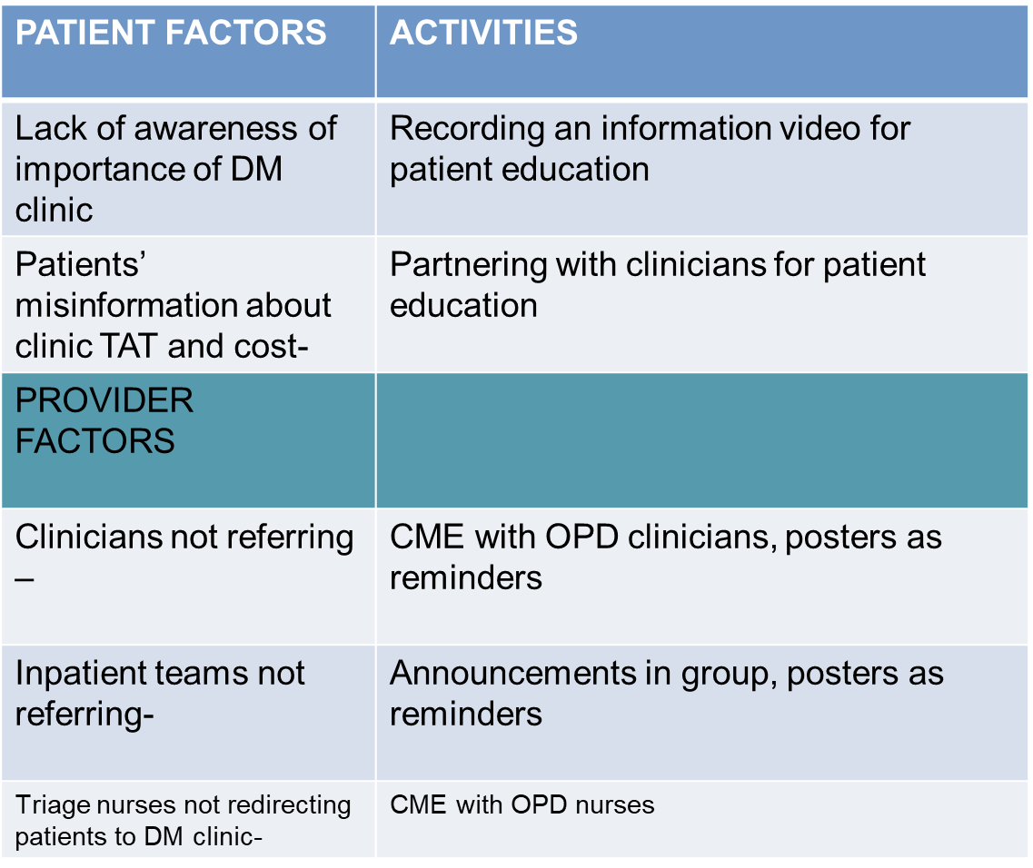
Problem Analysis

Slide 8
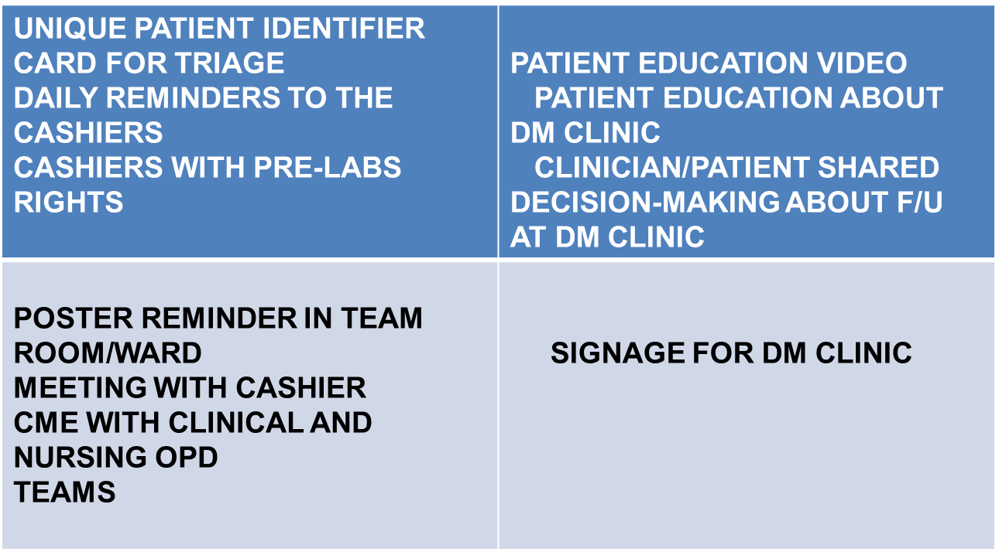
Synthesis Matrix

Slide 9
BASELINE
No. Of Patients

Slide 10
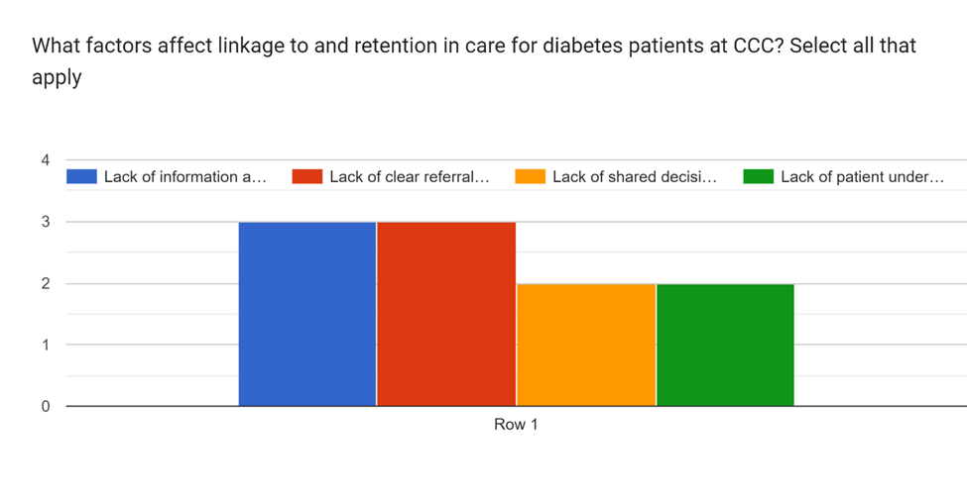
CURRENT STATE OF ANALYSIS
Based on the analysis, what are the root causes of your problem?
How did you analyse?

Slide 11
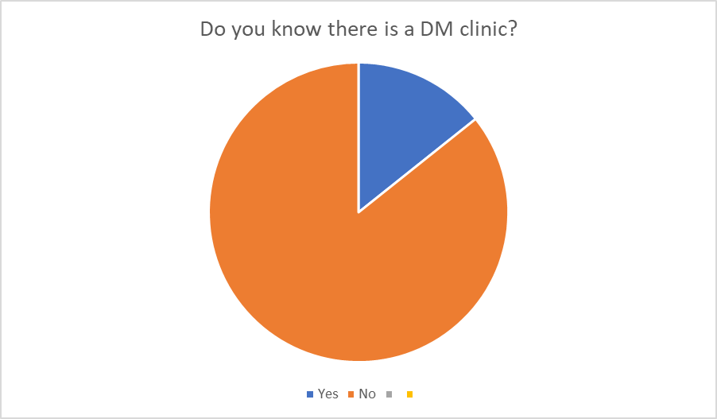
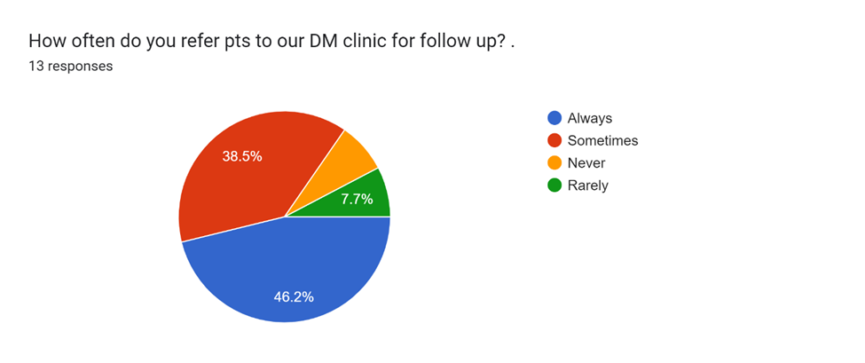
Current State Analysis

Slide 12
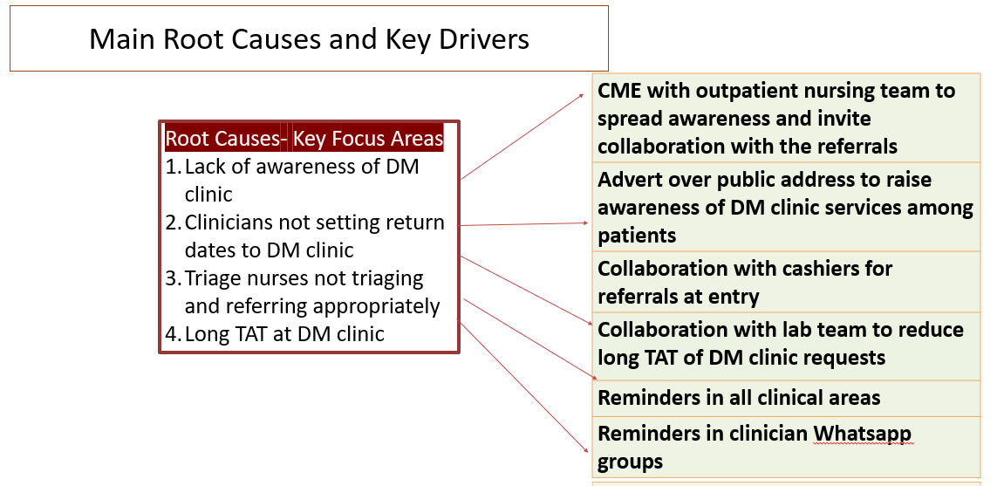
MAIN ROOT CAUSES AND KEY DRIVERS
Which causes did you focus on for your project? Why?
Did the key drivers change as you progressed through your project?
Did you discontinue any?

Slide 13
Main Root Causes and Key Drivers
CME with outpatient nursing team to spread awareness and invite collaboration with the referrals
Advert over public address to raise awareness of DM clinic services among patients + waiting area facelift
Collaboration with cashiers for referrals at entry
Collaboration with lab team to reduce long TAT of DM clinic requests
Reminders in all clinical areas
Reminders in clinician Whatsapp groups
Root Causes- Key Focus Areas
Lack of awareness of DM clinic
Clinicians not setting return dates to DM clinic
Triage nurses not triaging and referring appropriately
Long TAT at DM clinic

Slide 14
INTERVENTIONS
Display your key driver diagram with the interventions you want to review. Include reliability levels and maturity bars, barriers or abandoned. Show pictures of your interventions if available.
How did your interventions relate to your key drivers?
Which ones were the most impactful?
Are there interventions you did that didn’t work?

Slide 15
Interventions
Member Responsible
CME with outpatient nursing team to spread awareness and invite collaboration with the referrals
DM Clinic waiting area facelift
Collaboration with cashiers for referrals at entry
Collaboration with lab team to reduce long TAT of DM clinic requests
Reminders in all clinical areas
Reminders in clinician Whatsapp groups
Jennifer, Stella K
ALL
Annastacia, Jennifer, Virginia
John, Joram
Stella M, Jennifer
Stella W, Stella K

Slide 16
RESULTS
This is your power slide, and it’s best shown by inserting an annotated run chart. Display your run chart here and make sure it is annotated with…
just the key interventions.
Can you explain the hills and valleys in your chart data?
Which interventions impacted your metrics? Which did not?
Reveal your run chart….. piece by piece dramatically. Don’t show it all at once!

Slide 17
Results
start

Slide 18
Annualized Impact on Outcomes
Reduced TAT in obtaining services thereby increasing patient comfort
Patient-centered, comprehensive care received
Continuity of care of DM patients assured by patients being attended to by the same team throughout
Moving DM patients to DM clinic

Slide 19
SUSTAIN PLAN
Interventions to sustain | Owner | Sustain method and frequency | Report to
Reminders to Clinical and Nursing Team | Head of Nursing and Clinical Teams | Regular reminders, including new staff | OPD Head
What structures are embedded to ensure improvements will sustain?
Who will own the improvement? Are they aware of their duties?
Are new roles and responsibilities properly defined?

Slide 20
Key Learning Points
Change is possible
An attainable target encourages teams to work together
Policy helps sustain change
Next Steps
Next steps in finishing your project- record a video to raise awareness of DM clinic
Expanding improvements to the in-patient department
Continuing quality improvements within the DM clinic- TAT, waiting bay facelift

Slide 21
End of Slides
Delete this slide, example slides, instructions in red and all slides following

