Slide 1
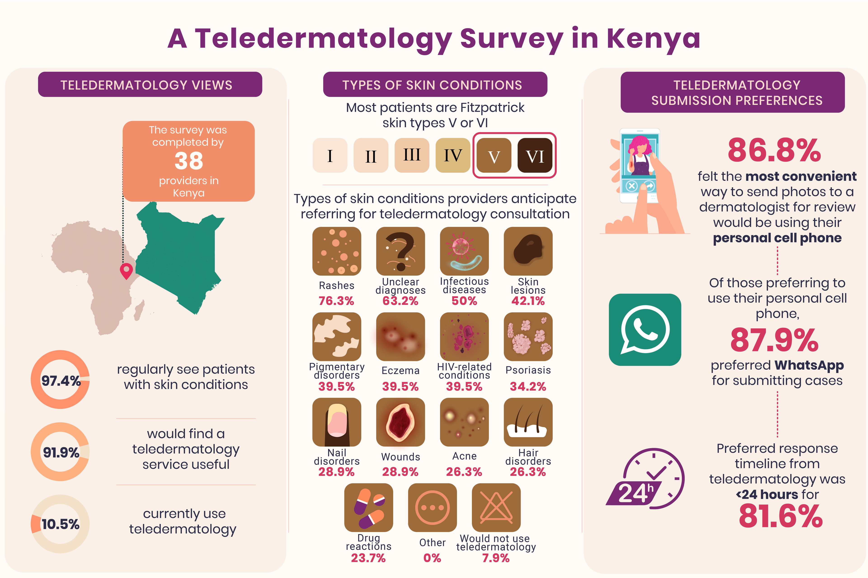
PRESENTER: ; ; Mary B. Adam, MD, MA, PhD^{3,} Hashim Kaderbhai, MBBS²; Jennifer L. Adams, MD¹; Rodney D. Adam, MD^{4,5}Jennifer Fernandez, MD, RD
Authors: Jennifer M. Fernandez, MD, RD¹
Affiliations:
Department of Dermatology, University of Nebraska Medical Center, Omaha, NE, USA
Department of Medicine, Section of Dermatology, Aga Khan University Hospital of Nairobi, Nairobi, Kenya
Africa Inland Church Kijabe Hospital, Kijabe, Kenya
Department of Medicine, Aga Khan University Hospital of Nairobi, Nairobi, Kenya
Department of Pathology, Aga Khan University Hospital of Nairobi, Nairobi, Kenya
Funding: Grant funding for this project was generously provided by the Skin of Color Society Research Award from the Skin of Color Society and the Skin Care for Developing Countries grant from the American Academy of Dermatology.
Figure created via Fiverr

