Slide 1
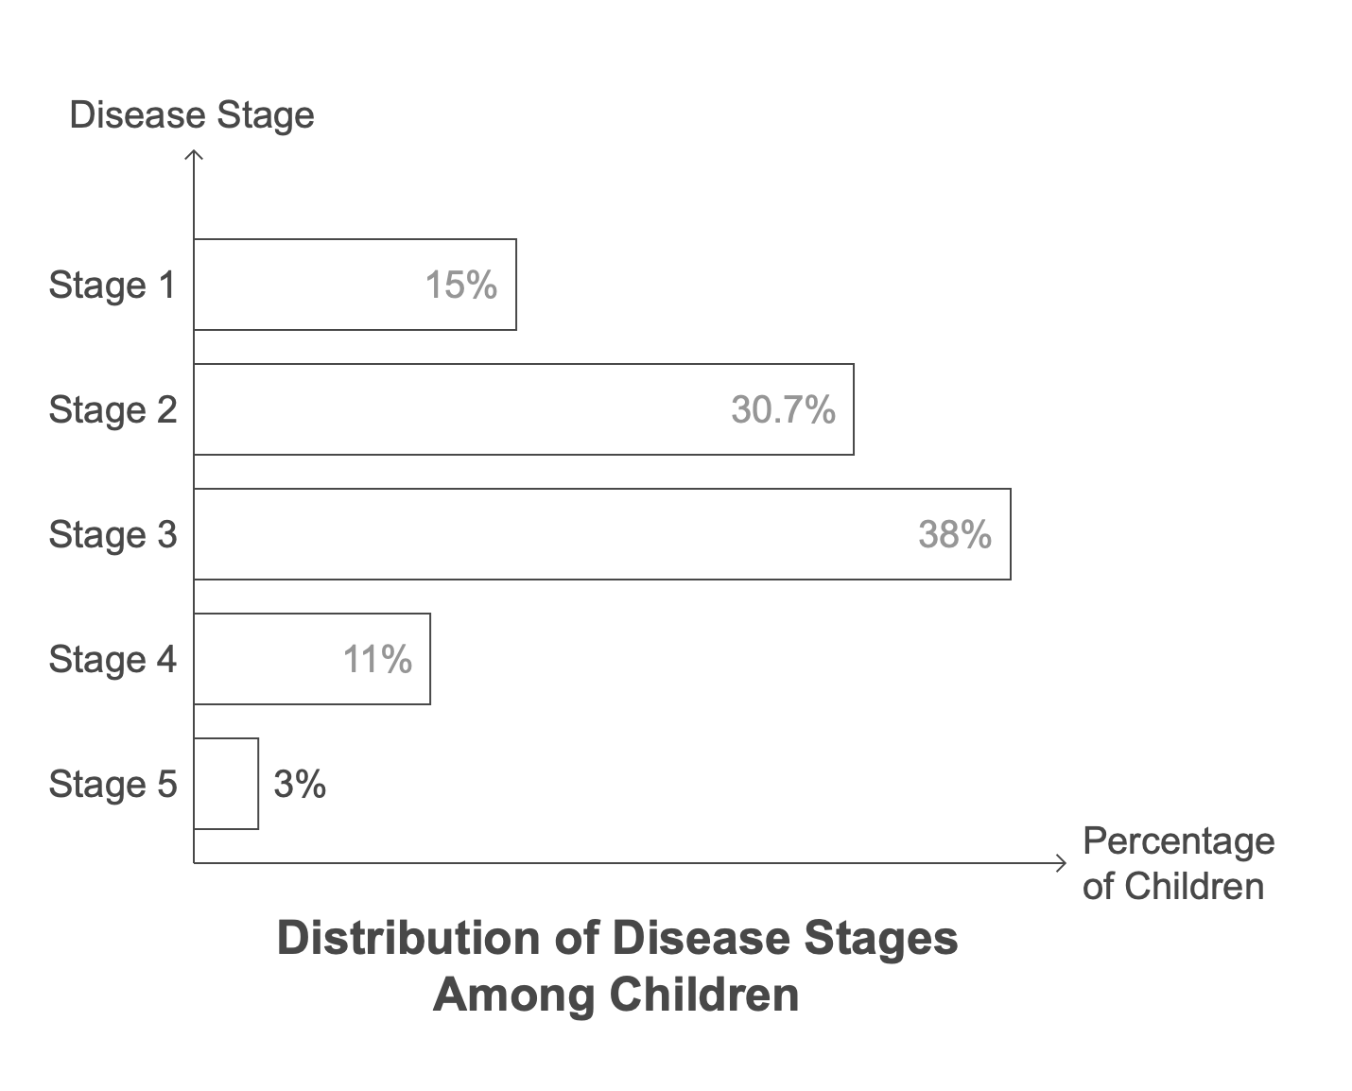
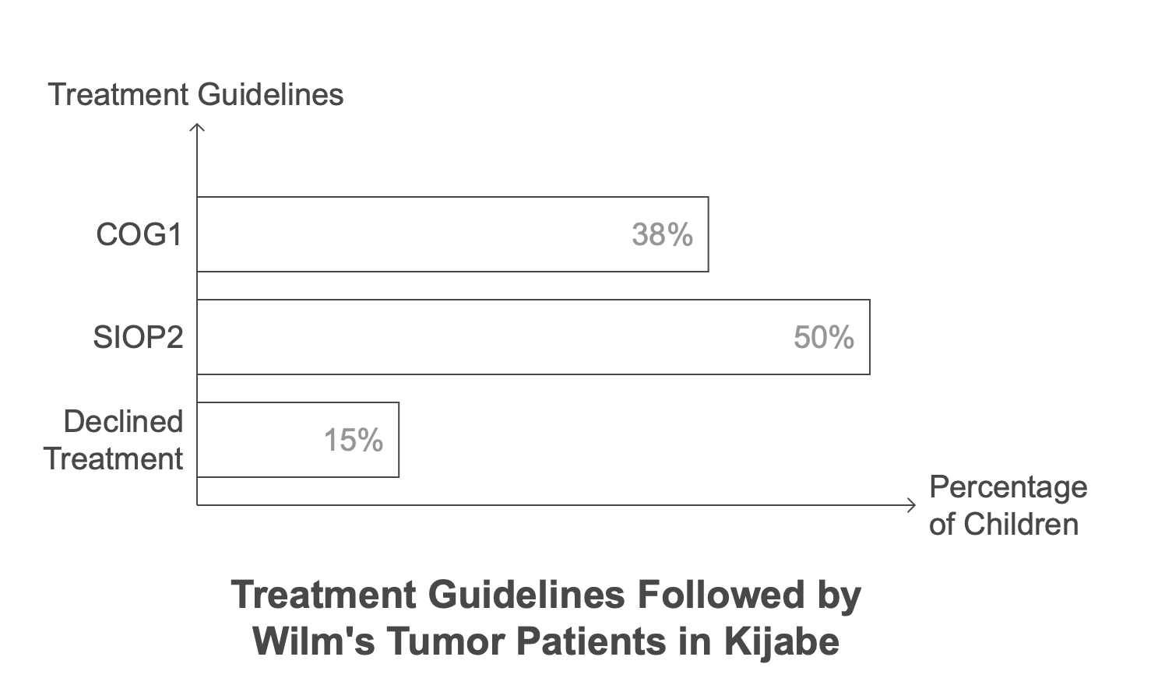
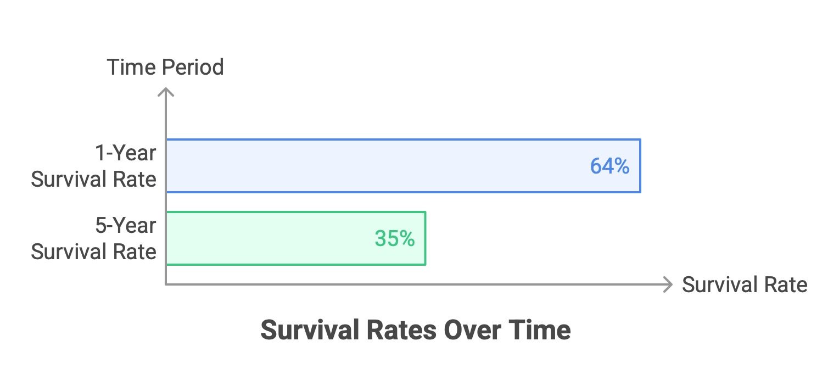
TREATMENT OUTCOMES OF WILM’S TUMOR: A FAITH BASED INSTITUTION’S EXPERIENCE
Michelle Obat, Ken Muma, Sarah Muma, Mehret Enaro, Muse Freneh
Introduction
Results
Conclusion
Wilms tumor is the 2nd most common solid cancer in children. High income countries have reported overall survival rates of more than 90% compared to less than 50% in low- and middle-income countries (LMIC). Late presentation, availability of drugs and surgery have been postulated as some of the potential reasons for this discrepancy. We assessed the treatments and surgical outcomes of children diagnosed with Wilms tumors, assess barriers to completion of treatment and factors contributing to treatment delays
Total of 28 cases with 12 male and 16 female (M: F= 1:1.3). The median age at diagnosis was 3 years with age range 1 year to 18 years. Nine children (38%) were treated using COG¹ guidelines. Mortality at year 2 was 100% for patients treated with COG guidelines. Thirteen children(50%) were treated using SIOP² guidelines and 4 (15%) declined treatment. Four children (15%) had stage 1 disease; eight (30.7%) had stage 2 disease;10 (38%) had stage 3 disease; 3 (11%) had stage 4 disease and 1 (3%) patient had stage 5 disease. Institution referrals comprised 65% while 34% were self-referral. 21 cases (75%) were beneficiaries of national health insurance (NHIF³).75% (21/28) of patients completed treatment and the loss to follow up rate was 3% (1/28). Financial constraint was the commonest cause of delayed treatment in 26 % (7/28) of cases. Relapse occurred in 15% (4/28). The 1-year, 3-year and 5-year survival rates were 64%, 35% and 17% respectively.
To improve outcomes a more collaborative approach is needed
Late presentation
Optimzation of appropriate treatment protocols
Health care financing.
MDT approach in the management of these patients
Proper patient navigation systems
Teamwork and communication
Disease Staging and Survival
Methods
Retrospective study doing chart review for patients treated in AIC Kijabe Hospital from Jan 2015 to June 2023. included children < 18 years with Wilms tumor.
Data collected included age, gender, referral location, health insurance availability, disease stage, treatment modalities used and treatment outcome.
References
Uittenboogaard A, Njuguna F, Mostert S, et al. Outcomes of Wilms tumor treatment in western Kenya. Pediatr Blood Cancer. 2022; 69:e29503 https://doi.org/10.1002/pbc.29503

