Slide 1

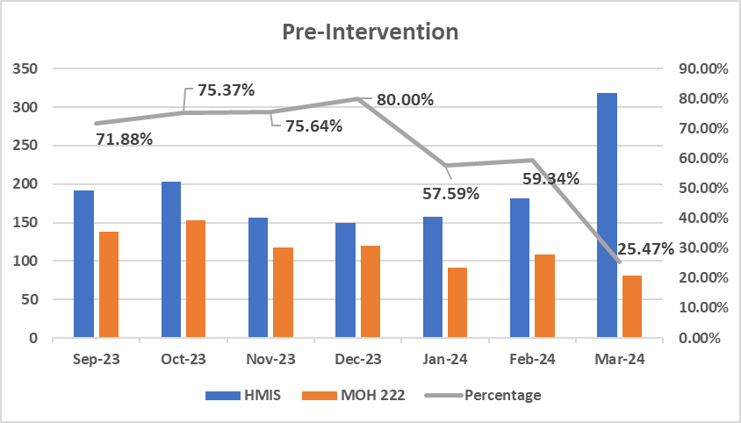
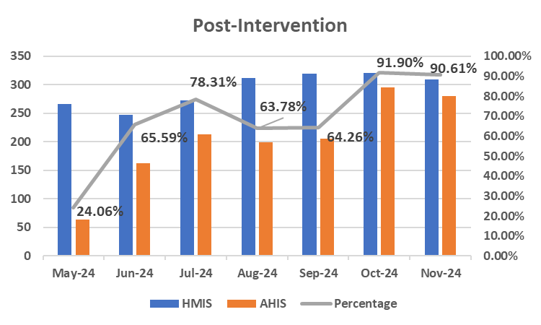
Improving the quality of documentation for Diabetes patients at a chronic care center, in a Faith-Based Tertiary Hospital in Kenya
AUTHORS: Elijah Ntomariu, Kelvin Gathima, Stella Mbugua, Albright M , Dr. Maria O, Tabitha M, Zablon W, Irene M, Bartholomew M, Belinda Jepkogei, Dr. Belyse Arakaza
BACKGROUND
Following the implementation of an e-version of MOH 222(AHIS), documentation rates increased significantly to 70% post intervention.
During the pre-intervention period (Sep 2023 - Apr 2024), documentation rates varied, with the highest at 80% and the lowest at 24.3% in Apr 2024 on the manual register.
In the post-intervention period (May - Nov 2024), initial uptake was very low at 24.1%. However, documentation gradually improved, to a high of 91.9%.
CONCLUSIONS
Patients Living with Diabetes require continuous monitoring and follow-up care to manage their condition effectively and prevent or address complications.
This requires an efficient tracking system to identify good practices and potential gaps in care provision.
The data from every clinic is fed to the subcounty database, which feeds the national database.
Regarding this, there is a daily activity register for diabetes, which summarizes the control and complications of every diabetic patient who comes to the clinic.
The challenges of filling these registers have been a recurrent due to workload, having one physical register at the clinic and inadequate orientation.
Improved documentation reflects acceptance of the new e-version of MOH 222(AHIS).
This has considerably improved patient monitoring in the chronic care centre for diabetes treatment.
It has also reinforced hospital reporting.
RECOMENDATIONS/CHALLENGES
Expanding the documentation process to include detailed information about all diabetes patients receiving care at the Chronic Care Centre (CCC).
Providing continuous training and orientation to new staff members and interns joining the clinic team.
Identifying and resolving problems that lead to incomplete entries at service delivery points.
A follow up QI be undertaken now assess the quality of care given ,complication rate and establish data driven interventions
MATERIAL & METHODS
A QI project was initiated to improve documentation practices at the clinic. The challenges were identified, and strategies to address them were established.
A dedicated QI committee was formed to lead sensitization efforts and actively participate in the development and testing of the AHIS tool.
Following deployment, both the nursing and clinical teams were urged to adopt and integrate the tool into their workflows.
ACKNOWLEDGMENT
We acknowledge the staff at the comprehensive care centre for accepting the challenge to use the AHIS tool.
Our clients, as our valued external stakeholders, play a crucial role in this process, benefiting from improved documentation and enhanced service delivery.
QI FINDINGS
The QI included a 7-month pre-intervention period (Sep 2023–Apr 2024), followed by a 1-month intervention phase in Apr 2024, during which AHIS was developed, tested and sensitization of health care workers was carried out.
The post-intervention phase ran from May to Nov 2024.
According to baseline statistics, the manual MOH 222 had an average completion rate of 54% over the pre-intervention period.
REFERENCE
MOH 222 daily register (Physical register)
Apex Health Information System (AHIS – Electronic version of the MOH 222 register)

