Slide 1









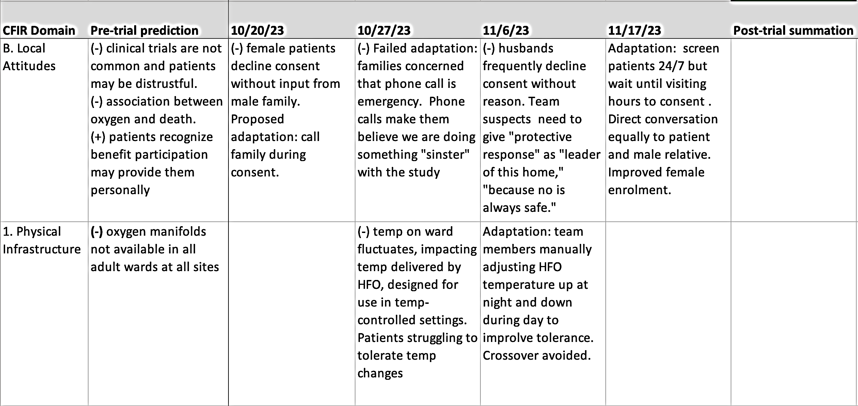
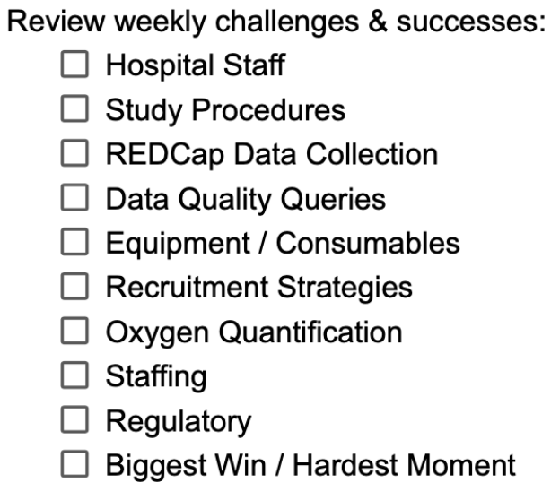
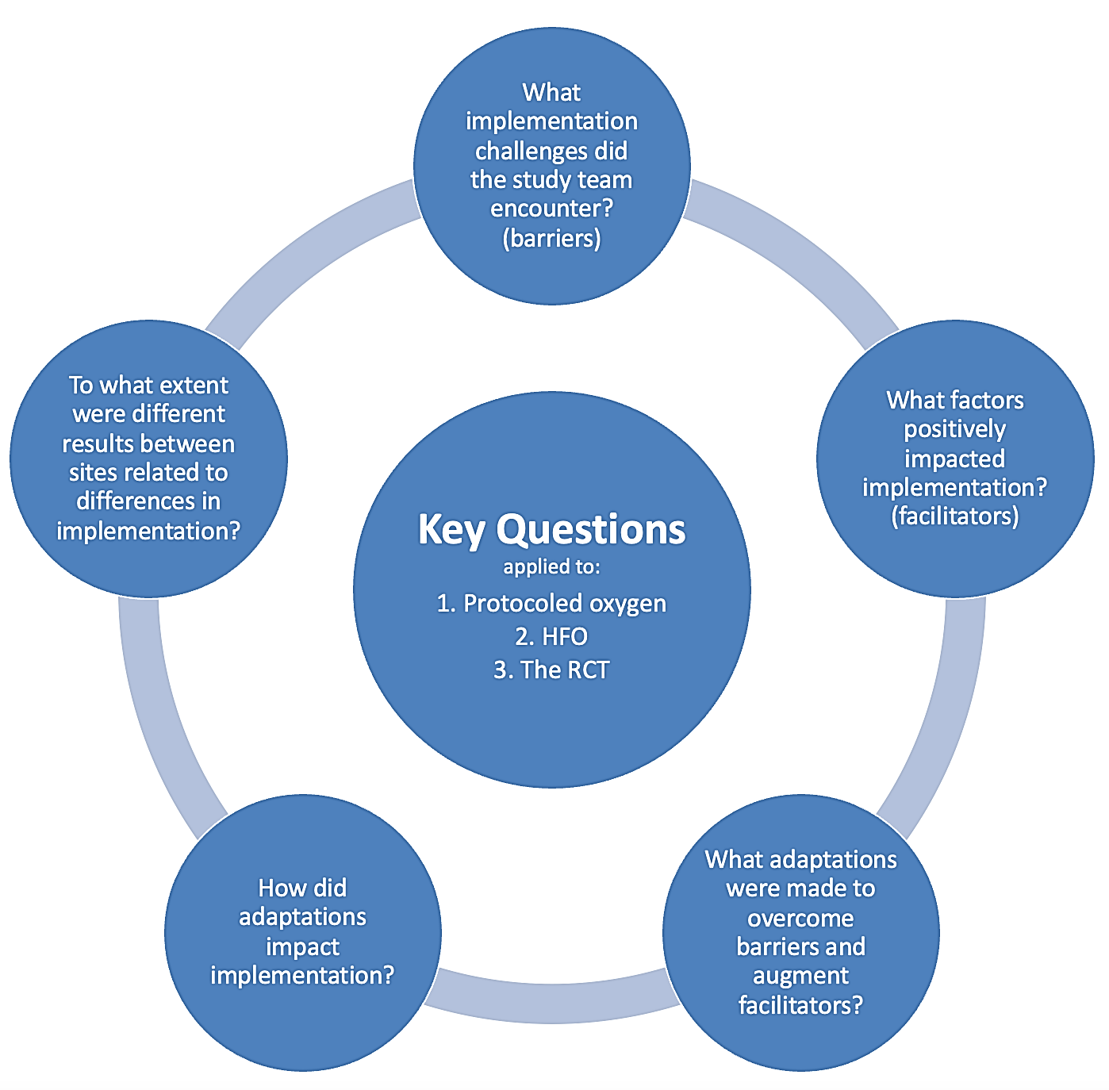
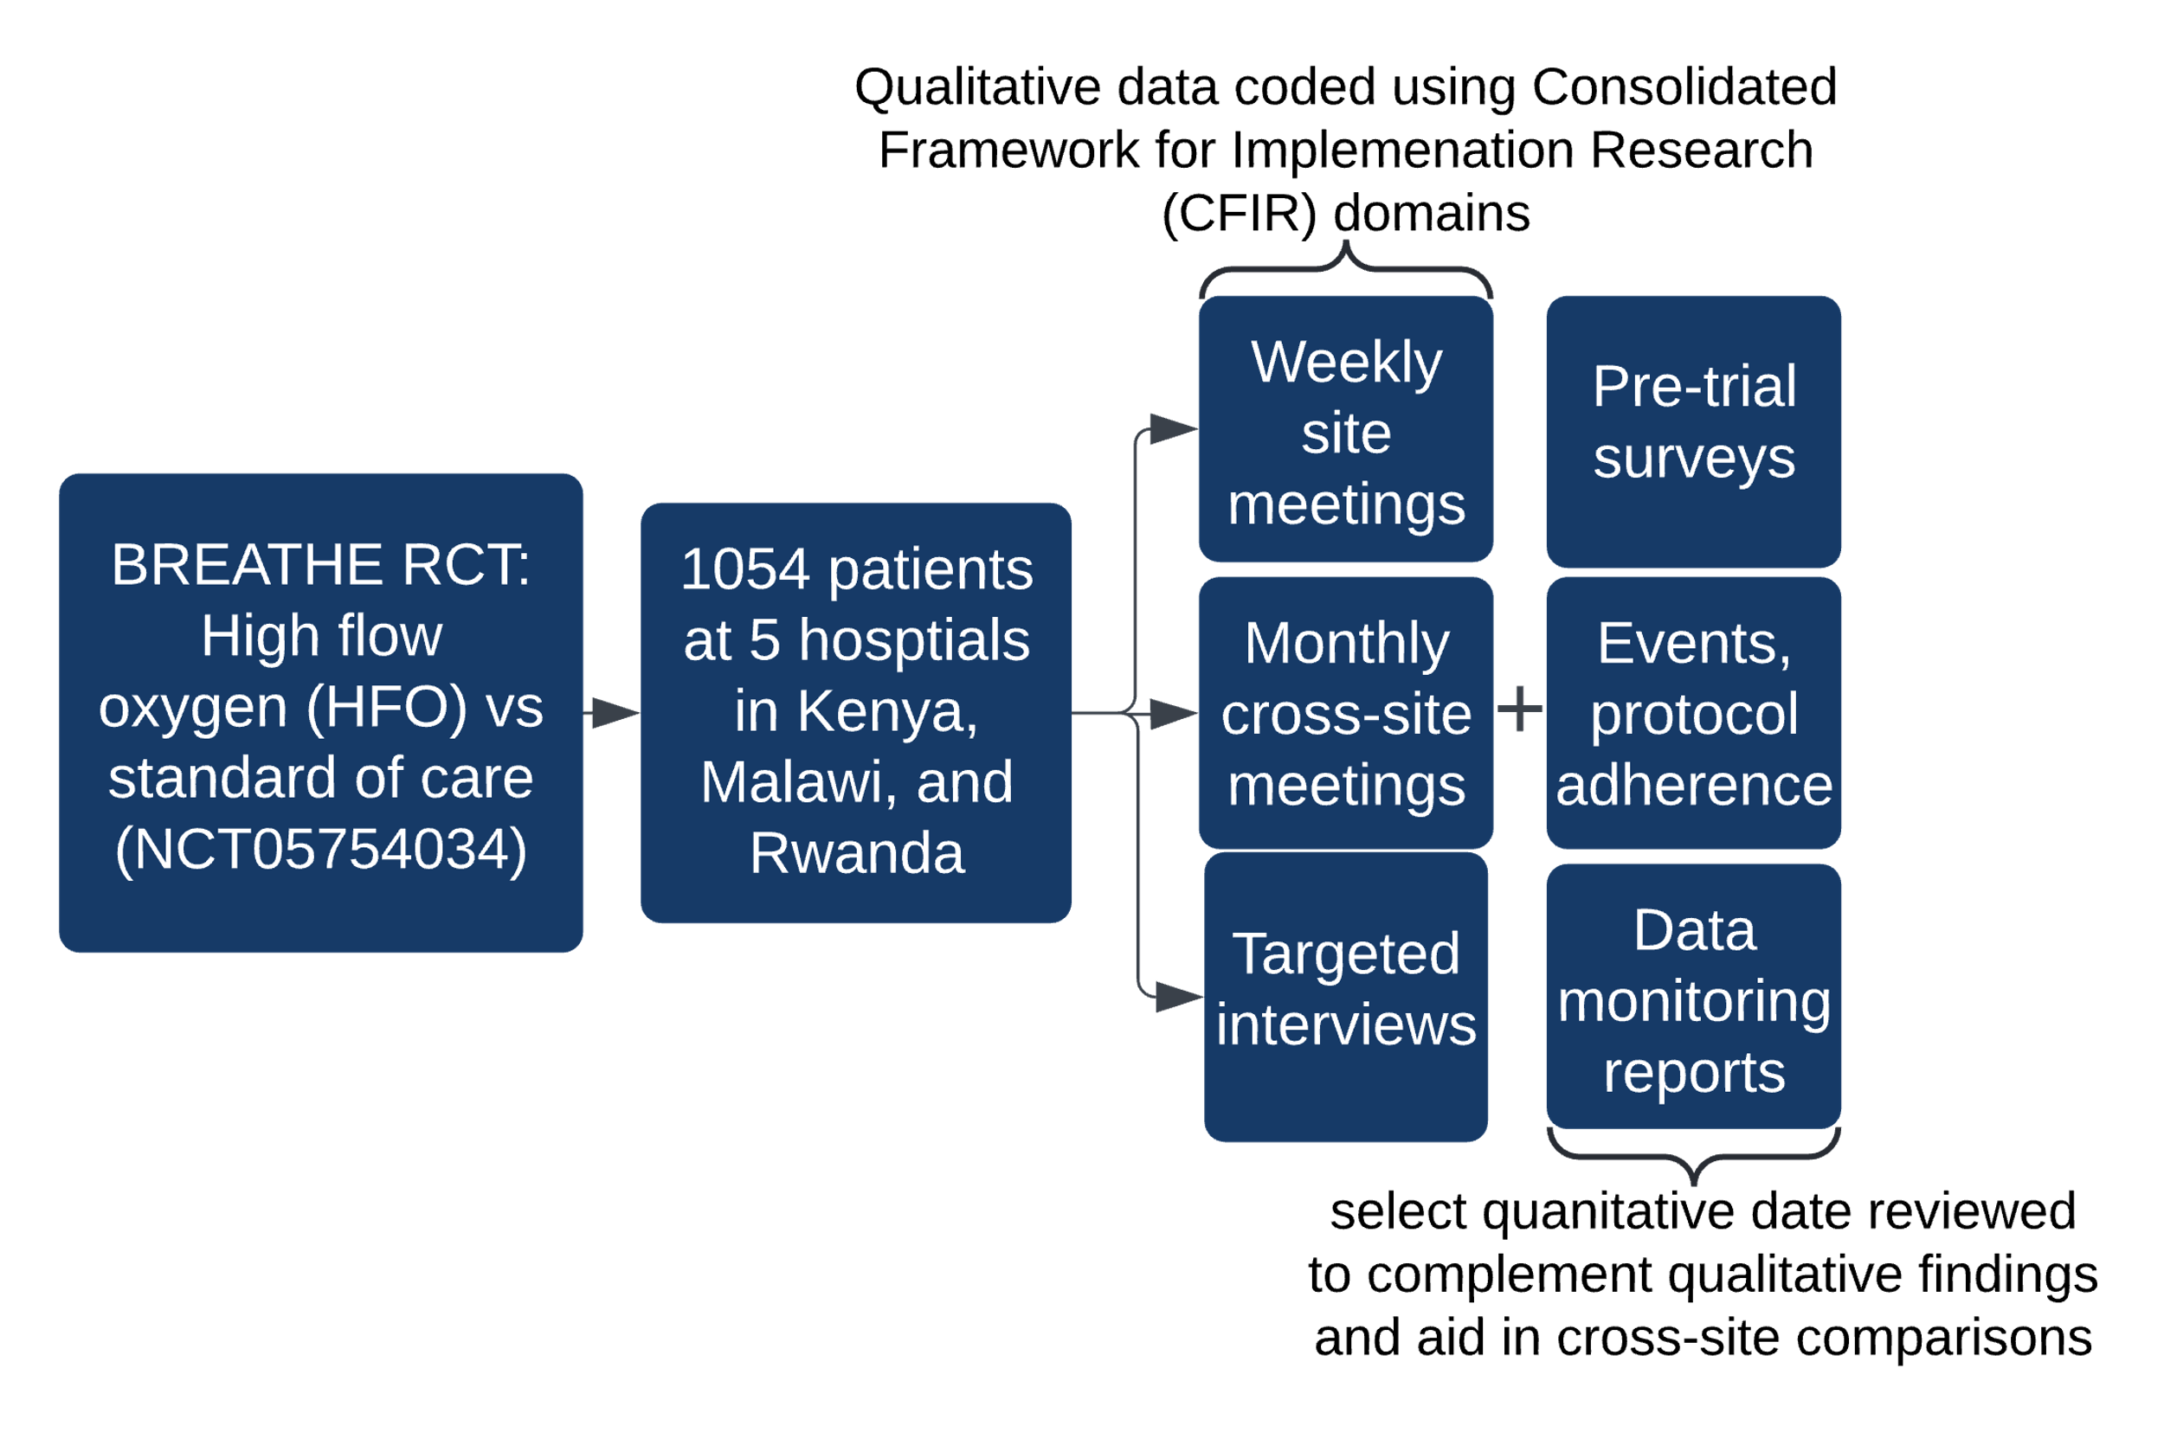
Evaluating the Process while Testing the Intervention: A Process Evaluation Protocol for the BREATHE Oxygen Therapy Randomized Controlled Trial in Kenya, Malawi, and Rwanda.
Tiara Calhoun, Lauren A. Onofrey, Felix Limbani, Valentine E. Rambula, Mary B. Adam, Ndaziona Peter Kwanjo Banda, Gahungu Blaise, Gashame Dona Fabiola, MD, Stephen Gordon, Nancy Haff, Esther Kageche, , Nelly Kebeney, Julie Lauffenburger, Peter Oduor, George Otieno, Innocent Sulani, Theogene Twagirumugabe, Uwamahoro Doris Lorette, Elisabeth Riviello, Jeanine Condo
Background
Process evaluation design
Limitations
While randomized controlled trials (RCTs) are the gold standard in clinical research, differences in implementation impact generalizability and reproducibility.
Process evaluation can inform RCT effectiveness results by describing the contextual factors, implementation factors, and causal mechanisms affecting outcomes.
This understanding allows for faster translation of trial results to clinical practice.
Sample data matrix
All study sites are academic referral hospitals
Analysis relies heavily on perspectives of study staff
Rapid coding method is employed
1. Group observations by CFIR domain
2. Capture barriers (-), facilitators (+), and adaptations longitudinally to observe impact
Clinical Implications
3. Identify themes within domains; summarize relative contribution, valence and trajectory of each theme
Provides a worked example for how to embed process evaluation within a clinical effectiveness trial.
Maximizes learning within RCT to speed adoption of interventions found to be effective
Helps stakeholders in similar resource-limited settings anticipate challenges implementing oxygen protocols, HFO, or a clinical trial
Purpose
To understand the implementation of a multicenter RCT at RCT-inexperienced hospitals in East Africa.
To identify barriers and facilitators unique to these settings as well as adaptations employed during the clinical trial to overcome barriers.
To create a model for embedded process evaluation within an acute care RCT for future researchers to employ.
4. Compare between sites
Future Directions
Team meeting checklist
Preliminary results are presented as poster number 3345 today
Full process evaluation will analyze team meetings, clinician interviews, patient/family interviews, and protocol adherence data through May 2025
Further work planned to understand how the RCT impacts clinical care generally at trial sites and how trial-related changes to clinical care are sustained
Process evaluation design
Contact and Acknowledgements
Contact & Acknowledgements
If you have any questions or suggestions, please feel free to reach out to tfcalhoun@mgb.org
This project is supported by the Wellcome Trust (Grant Number 222165/Z/20/Z) and the The Global Non-Communicable Diseases Research Training Program at Massachusetts General Hospital (T32HL166133)
Select quantitative data reviewed to complement qualitative findings and aid in cross-site comparisons

