Slide 1





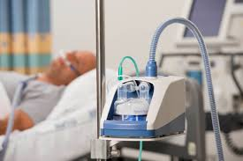
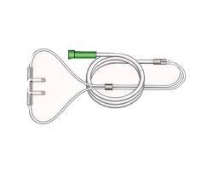
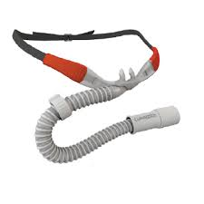
Building Respiratory Support in East Africa Through High Flow versus Standard Flow Oxygen Evaluation (BREATHE)
BREATHE Investigators: Dr. George O. Otieno¹ Nelly C. Kebeney¹ Valentine Rambula¹ Joseph G. Wainaina¹ James M. Mwinzi¹ Truphosa O. Awuor¹ Nelius Wairimu¹ Francis K. Irangi¹
Elisabeth Riviello, MD, MPH³.
1. BREATHE TEAM-AIC KIJABE HOSPITAL 2. WELLCOME TRUST-UK 3. BETH ISRAEL DEACONESS MEDICAL CENTER HOSPITAL 4. HARVARD MEDICAL SCHOOL TEACHING
Problem Statement
Methodology
1.Randomization
The randomization is an open-label trial on adults with hypoxemia admitted in the medical wards of AIC Kijabe Hospital ,determination through either SFO or HFO via a central randomization system. Participants are randomized in a 1:1 ratio. Randomization will be stratified by study center and severity of hypoxemia (imputed PaO2/FiO2<=300, <=200, and <=100), with permuted blocks with random block sizes.
2.Sampling-Blinding
The assignment is unblinded to the participant, participant’s surrogate, study staff, and clinical staff.
3.Sample size
A total of 211 patients will be recruited in a period of 15 months.
4.Eligibility criteria:
Inclusion criteria:
- Age>=18 years AND
- Admitted to a study site hospital AND
SpO2<90% at time of first assessment OR receiving oxygen at time of first assessment.
Exclusion criteria (any one of):
- Imminent death.
- Patient or caregiver refusal of study participation.
- History of chronic respiratory failure or oxygen dependence.
- Anatomical factors precluding the use of nasal cannula.
- Intubation by the clinical team prior to screening for the trial.
- Known hypoxemia at transferring facility for >48 hours.
- Lack of availability of either SFO or HFO devices or supplies at the time of randomization.
Outcome of Interest
Acute hypoxemic respiratory failure is a common and deadly component of critical illness in low income countries (LICs). An estimated 1.6 to 2.4 million people in sub-Saharan Africa develop respiratory failure requiring mechanical ventilation per year ; literature suggests this number is rising. Both oxygen, mechanical ventilators other oxygen delivery systems used for the most critically ill patients, are extremely limited resources in LICs. We hypothesize that using High Flow Oxygen may reduce oxygen consumption and the need for mechanical ventilation with similar or better outcomes.
Primary outcome measure
In-hospital mortality.
Secondary outcome measures
1. 90-day mortality.
2. 90-day functional status as measured by the World Health Organization Disability Assessment Schedule 2.0 (WHODAS 2.0).72,73.
3. Meeting objective criteria for need to escalate respiratory therapy to NIV or invasive ventilation.
4. Escalating to NIV or invasive ventilation.
5. Days requiring oxygen.
6. Hospital length of stay.
7. ICU length of stay.
Feasibility outcomes
1. Oxygen consumption.
2. Cost effectiveness.
3. Affordability.
4. Acceptability.
5. Input resources and processes
Broad Objective
To determine whether Breathing Support with High Flow Oxygen Therapy among hypoxemic patients could be more effective compared to Standard Flow while still conserving oxygen.
Development
Currently the BREATHE Study has;
Eligible-491 patients
Consented-141 patients
Randomized-141 patients
Enrolled 141 patients out of the 211 expected patients.
Randomized to HFO-70 patients
Randomized to SFO-71 patients

